Slide 1
Categories of Complaints
A guide to the most common protest personalities

Slide 2
Derrick Niederklein
Career public servant:
Nebraska’s Property Asmnt Div.
Lancaster County Deputy Assessor
MIPS Deputy Director

Slide 3
Derrick Niederklein
Career public servant:
Nebraska’s Property Asmnt Div.
Lancaster County Deputy Assessor
MIPS Deputy Director
Doer of Good.

Slide 4
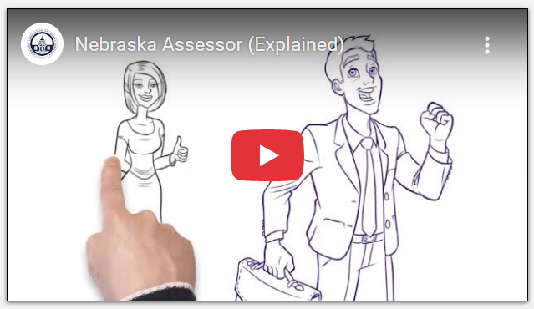

Slide 5
Protest Season is Healthy!!
In Mass Appraisal, not every property valuation is perfect.
Judgments are based on exterior reviews of property.
Owners have a voice in the process
Opportunity to gather more facts to get it right!!

Slide 6
Protest Season is Healthy!!
In Mass Appraisal, not every property valuation is perfect.
Judgments are based on exterior reviews of property.
Owners have a voice in the process
Opportunity to gather more facts to get it right!!

Slide 7
Public Says….

Slide 8
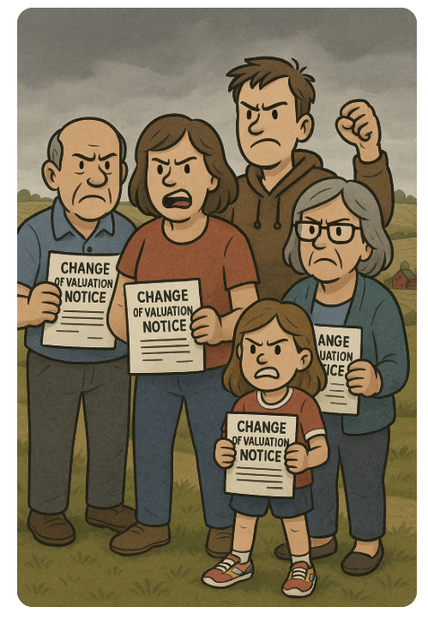

Slide 10
Comments:
“They’ve raised mine 4 times in the last year and a half”

Slide 11
Comments:
“They’ve raised mine 4 times in the last year and a half”
“Heard New roofs add like 40k value”

Slide 12
Comments:
“They’ve raised mine 4 times in the last year and a half”
“Heard New roofs add like 40k value”
“Raised ours 3 times in 18 months. Guess they need another sportsball facility”

Slide 13
Comments:
“They’ve raised mine 4 times in the last year and a half”
“Heard New roofs add like 40k value”
“Raised ours 3 times in 18 months. Guess they need another sportsball facility”
“Ring Doorbells are awesome ☺”

Slide 15
Objectives for Today:
Common “Categories” of Complaints
Tips for ‘redirecting’
Tips for ‘educating’
Tips for ‘representing’ constituents.

Slide 17
The "Informed" Owner
“I don’t have a finished basement anymore”
“My house is in worse shape than the assessor thinks”
“My mobile home is listed as a stick-built house”

Slide 18
The "Informed" Owner
“I don’t have a finished basement anymore”
“My house is in worse shape than the assessor thinks”
“My mobile home is listed as a stick-built house”
💡 Tip: Trust, verify, then correct.

Slide 19
The Misinformed Owner
Image Placeholder
(Insert image manually here)

Slide 20
The Misinformed Owner
“My taxes are going up, and I don’t like it.”
Thinks value = taxes
Doesn’t know what a levy is
Brings last year’s tax bill, not comps

Slide 21
The Misinformed Owner
“My taxes are going up, and I don’t like it.”
Thinks value = taxes
Doesn’t know what a levy is
Brings last year’s tax bill, not comps
💡 Tip: Use this as a teachable moment!

Slide 22
The Anti-Government Skeptic

Slide 23
The Anti-Government Skeptic
“You’re just trying to take our money!”
Distrusts the system
May mention "backdoor revenue grabs”
Refuses to believe the value went up with the market

Slide 24
The Anti-Government Skeptic
“You’re just trying to take our money!”
Distrusts the system
May mention "backdoor revenue grabs”
Refuses to believe the value went up with the market
💡 Tip: Be transparent and calm—facts help (sometimes).

Slide 25
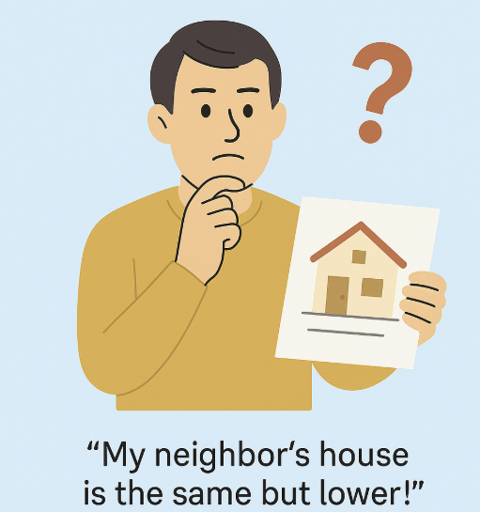
The Comparer

Slide 26
The Comparer
“My neighbor’s house is lower!”
Relies on porch talk and online listings
Ignores basement finish, garage count, or recent remodels.
Will bring you photos… from 2006

Slide 27
The Comparer
“My neighbor’s house is lower!”
Relies on porch talk and online listings
Ignores basement finish, garage count, or recent remodels.
Will bring you photos… from 2006
💡 Tip: Have neighborhood comps ready.

Slide 28
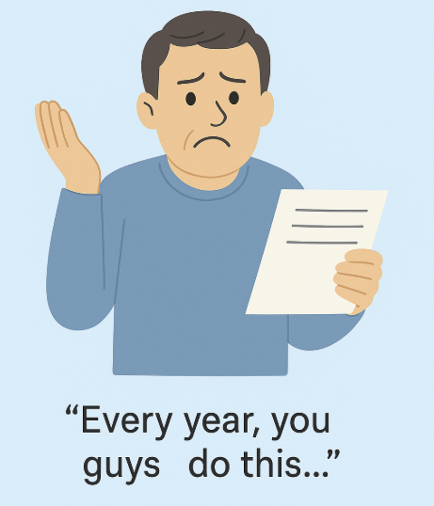
The Chronically Unhappy Taxpayer - Visual

Slide 29
The Chronically Unhappy Taxpayer
“Every year, you guys do this…”
Protests annually out of sheer habit
Often vague: “It’s just too high.”
Usually never satisfied with any answer

Slide 30
The Chronically Unhappy Taxpayer
“Every year, you guys do this…”
Protests annually out of sheer habit
Often vague: “It’s just too high.”
Usually never satisfied with any answer
💡 Tip: Document facts and manage expectations.

Slide 31
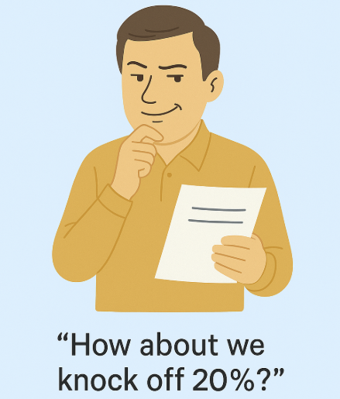
The Strategic Under-Valuer

Slide 32
The Strategic Under-Valuer
“Let’s just see if they’ll lower it a bit.”
Knows the process cold
Will use math, leverage, lawyers… or all three
Their motto: “It never hurts to ask”

Slide 33
The Strategic Under-Valuer
“Let’s just see if they’ll lower it a bit.”
Knows the process cold
Will use math, leverage, lawyers… or all three
Their motto: “It never hurts to ask”
💡 Tip: Stick to the data. Stay consistent.

Slide 34
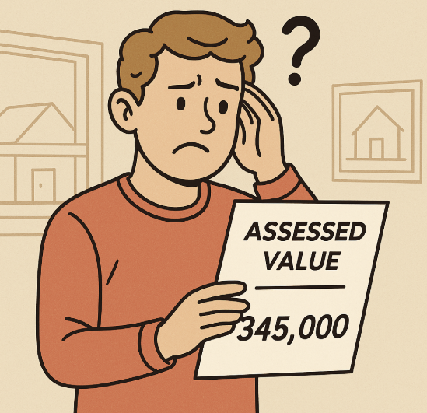
The Confused Recent Buyer

Slide 35
The Confused Recent Buyer
“But I just bought it for less!”
Assumes all sales are equal
Doesn’t understand non-arm’s-length deals
Brings the bank appraisal like it’s a golden ticket

Slide 36
The Confused Recent Buyer
“But I just bought it for less!”
Assumes all sales are equal
Doesn’t understand non-arm’s-length deals
Brings the bank appraisal like it’s a golden ticket
💡Tip: Explain market lag, “the most probable” selling price as of January 1st.

Slide 37
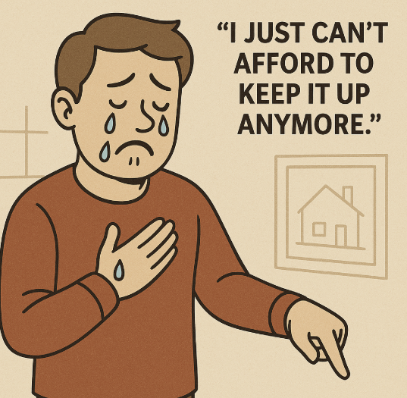
The Emotional Owner

Slide 38
The Emotional Owner
“It’s falling apart, and it’s my *childhood home*.”
Sees value through nostalgia
Points out chipped paint, not structural facts
“No one else would want it!”

Slide 39
The Emotional Owner
“It’s falling apart, and it’s my *childhood home*.”
Sees value through nostalgia
Points out chipped paint, not structural facts
“No one else would want it!”
💡 Tip: Validate feelings, then gently redirect to market data.

Slide 40
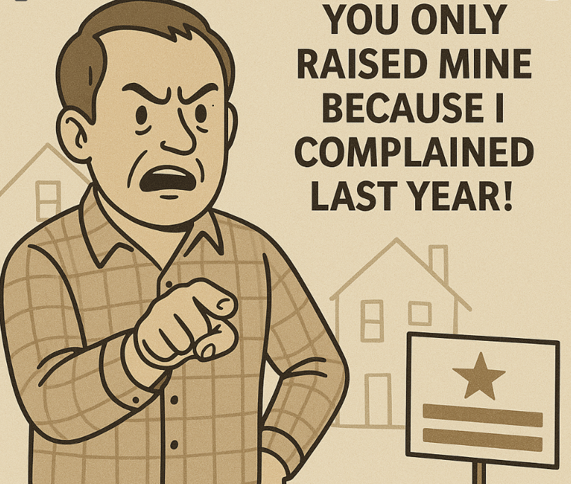
The Conspiracy Theorist

Slide 41
The Conspiracy Theorist
“You only raised mine because I complained last year!”
Believes they’ve been targeted
Expects fairness to mean “everyone changes the exact same percentage”

Slide 42
The Conspiracy Theorist
“You only raised mine because I complained last year!”
Believes they’ve been targeted
Expects fairness to mean “everyone changes the exact same percentage”
💡 Tip: Keep things objective and documented.

Slide 43
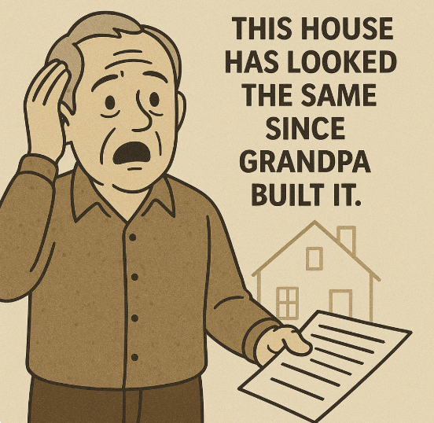
The Stangator

Slide 44
The “No Updates” Shock
“This house has looked the same since Grandpa built it.”
Shocked at current market value
- Mentions what they *paid* for it in 1993

Slide 45
The “No Updates” Shock
“This house has looked the same since Grandpa built it.”
Shocked at current market value
- Mentions what they *paid* for it in 1993
💡 Tip: Walk through appreciation trends.

Slide 46
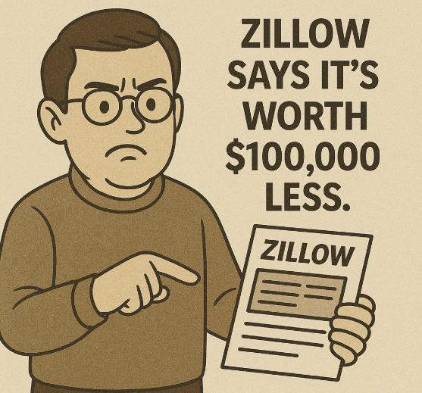
The Online Expert

Slide 47
The Online Expert
“Zillow says it’s worth $100,000 less.”
Has printouts
Doesn’t understand AVMs or sales validation
“Well, my Realtor friend agrees with me…”

Slide 48
The Online Expert
“Zillow says it’s worth $100,000 less.”
Has printouts
Doesn’t understand AVMs or sales validation
“Well, my Realtor friend agrees with me…”
💡 Tip: Gently explain how mass appraisal differs from online guesses.

Slide 49
The Soil Scientist

Slide 50
Soil Sadness ☹
Brings Jars of dirt to show soil differences
Argues the NRCS soil survey is wrong
Feels misunderstood by the process
“Income is limited south of the waterway…”

Slide 51
Soil Sadness ☹
Brings Jars of dirt to show soil differences
Argues the NRCS soil survey is wrong
Feels misunderstood by the process
“Income is limited south of the waterway…”
💡 Tip: Explain ‘total market value’ of the parcel.

Slide 52
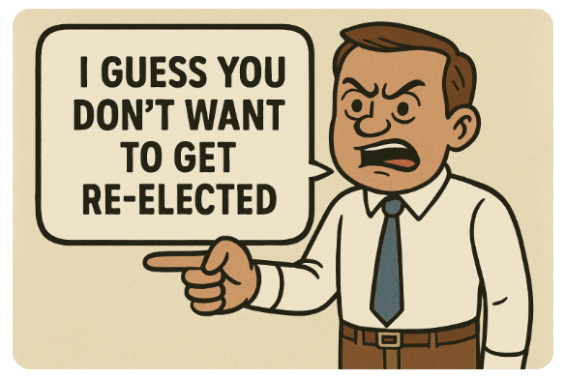
The Intimidator

Slide 53
The Intimidator
Wants you to recognize *who they are*
“I do a lot for this community…”
“I’d sure hate for this information to get leaked..”
“We had higher hopes for you…”

Slide 54
The Intimidator
Wants you to recognize *who they are*
“I do a lot for this community…”
“I’d sure hate for this information to get leaked..”
“We had higher hopes for you…”
💡 Tip: Hear them…ask for information/data..
… and then, blame the law.

Slide 55
A Little Logic & A Lot of Patience
Everyone has a story.
✅ Stick to facts
✅ Stay empathetic
✅ Be consistent

Slide 56
A Little Logic & A Lot of Patience
Everyone has a story.
✅ Stick to facts (and gather more if needed)
✅ Stay empathetic (“I hear you”)
✅ Be consistent (stick to the value structure)

Slide 57
A Little Logic & A Lot of Patience
Everyone has a story.
✅ Stick to facts (and gather more if needed)
✅ Stay empathetic (“I hear you”)
✅ Be consistent (stick to the value structure)
And remember: It's not personal—it's just protest season!

Slide 58
Questions?

