Slide 1
NEW HIRE PACKET
We all have different situations, pay cycles, benefits, handbook rules, etc. The scenarios in my presentation will be based on my county’s policies and my own methods.

Slide 2
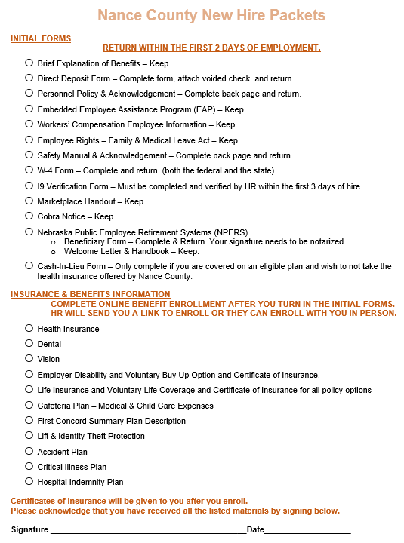
New Hires
When I have a new employee, I give them a “New Hire Packet”. My new hire packet includes notes that let the employee know if the form is required to return, optional to complete, or information for them to keep. The top page of the packet is a checklist I require the employee to sign at the end of their enrollment process signifying they have received/completed all the listed information. I try to make sure the checklist is in the same order as the documents in the packet.

Slide 3
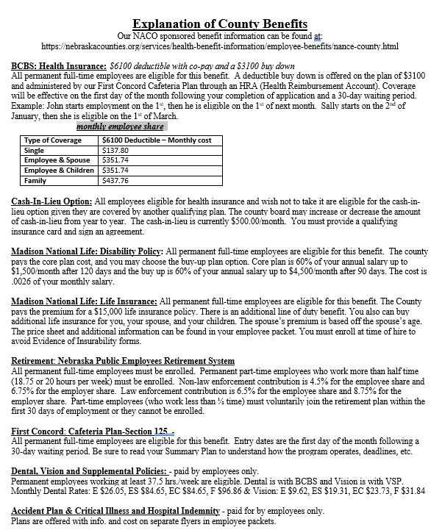
Initial Forms
The first page after the checklist is a brief explanation of benefits as this is usually one of the first things the new hire asks about. It gives a very brief description of our core county benefits and includes the employee share of the premium for the health insurance, dental, and vision plans.
Next in the packet are manuals, direct deposit forms, required state and federal handouts, the W4’s, the I-9 form, etc. The employee is instructed to return that portion of the packet by the end of their 2nd day of employment.
When they return that initial paperwork, I can verify their I-9 form, enter them into the MIP’s systems payroll side and the time and attendance, and then activate their online enrollment process. For the new hires I normally do the online enrollment with them. For open enrollment they either do it with the benefits expert or on their own.
  **I would advise that you require all employees to complete the entire open enrollment process.

Slide 4
Deductions are influenced by an employee’s start date and pay cycles. Understanding and calculating the correct premium deductions for the initial period is essential to ensure timely and accurate payroll.
Benefit Start Dates, Pay Cycles & Open Enrollment
Employees starting on the first of a month are enrolled in benefits the first of the following month, while starts on other days require a 30-day wait. For instance, an employee starting on January 2 becomes eligible for health insurance on March 1.
Elected officials start their benefits the day they take office. They will not receive a paycheck before they start to deduct their benefits from. If the premium is paid in advance you will need to deduct two months premiums out of their first month of paychecks.
Open Enrollment
Our open enrollment is effective July 1st. I try to get open enrollment done by the first week of June. This gives me time to get all deductions updated in the payroll system for their June paychecks to pay the July premiums.

Slide 5
Balancing Deductions
In a perfect world we should balance with our bills every month.
WE ALL KNOW THIS DOES NOT HAPPEN!!
In some cases, you will not be aware of the change until you receive the bill.

Slide 6
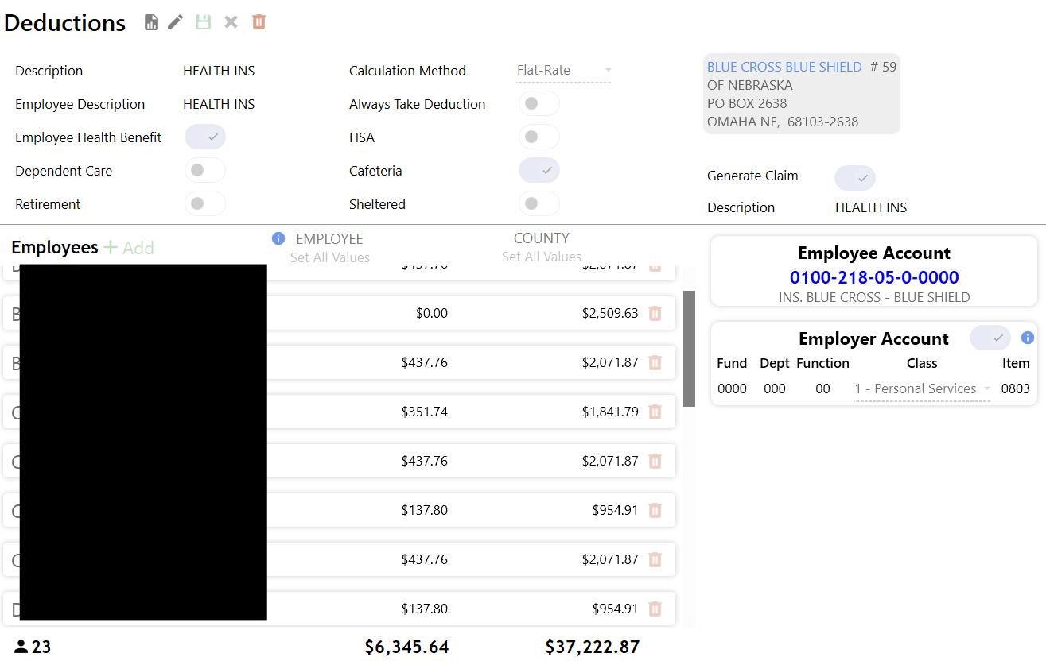
Balance
the Deductions
MIPS new software has a page and a report that will show the current monthly deduction amount listed for each employee within each deduction type. It will show both the employee and the employer share. I use this report to balance the current itemized bill. The new software allows you to make edits to the employee’s deductions from this page instead of having to go to their individual deduction listing like the old system.

Slide 7
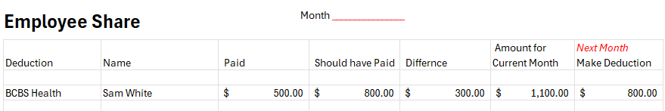
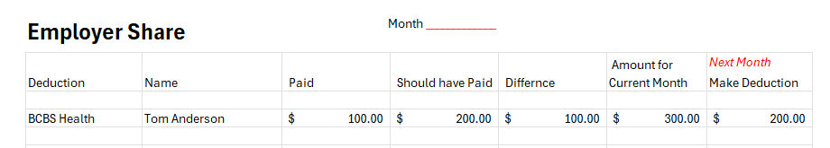
Adjustments
I use an excel worksheet to track my adjustments and then file them by month with the employee’s time and attendance information and employee requested PTO slips.
This worksheet lists the deduction type, name of employee, what I deducted in the previous month (incorrect amount paid), what I should have deducted (what should be billed), the difference, what I need to deduct for the current month to make the adjustment, and the correct billed deduction amount for the next month.
I have a worksheet for the employee share and one for the employer share.
Example: It’s the end of September and all payroll for the month is complete. The employee had a life event that changed their deduction amount. I would label the top of the worksheet October and then label the last column of the worksheet November. Next, I would edit their deduction amounts in the MIPS software for their October payroll from the “Amount for Current Month” column, and then in November, before I run the payroll, I will correct the deduction amount in the MIPS software to the correct billed amount from the “Next Month” column.

Slide 8
Reimbursing Employee & Correcting Employer Overpayments
When an employee is terminated, a qualifying event occurs, or the premium changes due to age, etc., you may need to reimburse premiums previously made.
In addition, a correction to the overpayment on the bill will need adjusted.

Slide 9
Reimburse Employee Deductions
Know
First you need to know what type of deduction it is. If it was a pre-tax (cafeteria) or post-tax deduction.
Pre-tax
Pre-tax deductions will need to be reimbursed as a fringe benefit so taxes can be taken out but not a retirement contribution.
Post-tax
Post-tax deductions can be reimbursed as a vendor check to the employee.

Slide 10
Reimbursing The Employee For Deductions.
Know
  It is important that you know how 218 accounts work and that they must balance. 218 accounts are not part of our budgeted expenses but are the holding accounts for the employee’s share of deductions.
Pre-tax
  If reimbursing an employee on a pre-tax deduction you will not only need to reimburse the employee and correct the bill, but you would you also need to reimburse the County for reimbursing the employee. To do this you set up a fringe benefit under the employee’s deduction listing to reimburse the employee. Then you would subtract the reimbursement amount from the vendor invoice to balance the bill and last, you’d add an invoice to reimburse the County the same amount to balance the 218 line item and reimburse the County. For example: Bob paid $200 too much for their share of health insurance. You reimbursed Bob using a fringe benefit deduction. When those payroll invoices are created you would then subtract that $200 from the health insurance 218 line item to correct the bill and then add an invoice payable to the County for $200 with the same 218 line item.
Post-tax
  If reimbursing an employee on a post-tax deduction, you would process the payroll invoices. Then from those invoices you would find the 218 line item it originated from and subtract the reimbursement amount to correct the overpayment on the bill. Last, you would add an invoice to reimburse the employee using the same 218 line item.

Slide 11
Correcting Employer Deductions
Know
You will want to make sure you are crediting the right function/dept when correcting the overpayment.
Correcting the Bill
When invoices are generated for the next payroll, you will subtract the overpayment amount from the originating budgeted line item.

Slide 12
Termination
Besides reimbursing the employee for any overpaid deductions you may have other termination responsibilities.
I always make sure the department head/elected official is okay with processing their last paycheck. Our policy states they must return all property before final paycheck.
We send out an exit letter/survey with a self addressed stamped envelope by certified mail. We also include any Cobra paperwork that is not sent by NACO.
I give them the contact information for any retirement plans associated with the County.
Make sure and process the non-contributing member form with NPERS after you send in their last contribution.

