Slide 1
Legislative Updates 7.24.25
Budget Caps, Joint Public Hearings and Growth Value

Slide 2
LB650 and LB647 – JPH Postcards
LB650: Community Colleges –no longer will participate in the joint public hearing
LB647: Harmonized the definition of growth in three statutory definitions.
**Counties will use the same growth number for budget cap formula and postcards.

Slide 3
Certification of Taxable Value and Allowable Growth Value

Slide 4
APA County Budget Forms- Growth

Slide 5
APA County Budget Forms- Growth

Slide 6
LB647 – Budget Changes – Cap Walk-Thru
How to determine how much you need in property taxes?
Budget Formula is Necessary Cash Reserve + Budgeted Disbursements = Total Requirements
Beginning Fund Balance + Budgeted Receipts for NON- Property Taxes + Property Taxes = Total Resources Available
Total Requirements MUST equal Total Resources Available
Jeff Schreier, CPA Audit Manager
Nebraska Auditor of Public Accounts

Slide 7
LB647 – Budget Changes – Cap YEAR 1
Same Year 1
No Exceptions to Subtract Year 1
Same Year 1

Slide 8
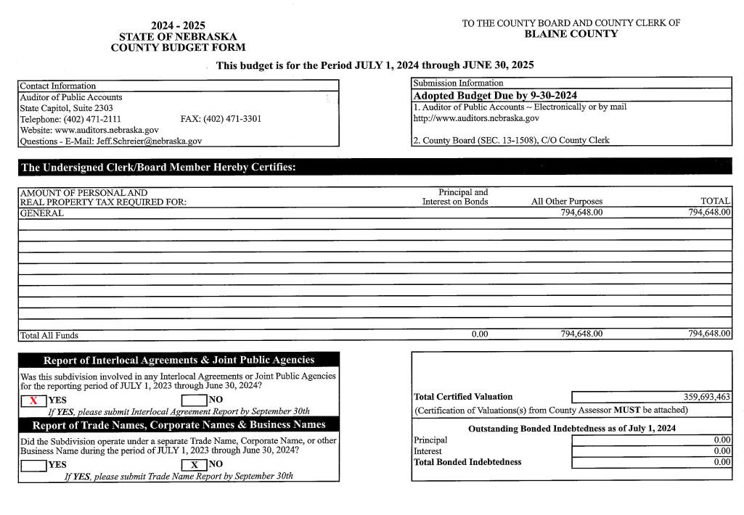
LB647 – Budget Changes – Cap YEAR 1

Slide 9
LB647 – Budget Changes – Cap Walk-Thru
DOR Report
From CTV

Slide 10
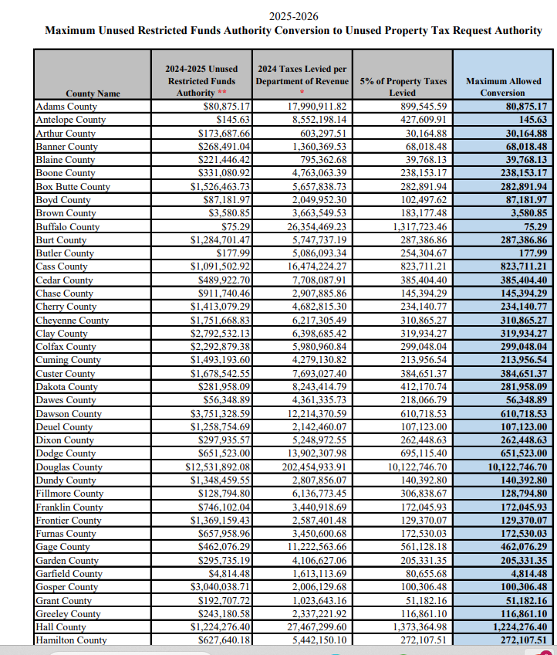

Slide 11
Certification of Taxable Value and Allowable Growth Value

Slide 12
This Year Only- Ref. APA Website for Correct Amount 24.
This is County’s Taxing Authority 26.
Taxes needed to meet requirement 27.

Slide 13
LB647 – Budget Changes – Cap Walk-Thru
As a reminder: All offices complete their budget request the same as years prior.
Exceptions under the Authority Computation Form is a function of creating property tax authority – determination made by the county board. (same as lid on restricted funds)
General Fund Revenues are part of the budget formula to determine property tax request – not office specific.
Year Two: Prior year exceptions are subtracted from county authority prior to increasing the Growth and Inflation percentages. Recommendation: Determine if county has enough property tax authority before considering entering a recurring expense for an exception.
Unused Property Tax Request Authority is capped. Starting in 26-27 budget year, this carryforward is limited to a maximum of 5% of the total property tax request authority from the prior year.

Slide 14
Setting Up- Cash Reserves and Sinking Fund
Reserves offer protection against unplanned, unavoidable cost or losses.
Reserves are a savings account: deferred spending as a way to manage risk.
Reserves are an insurance policy to manage volatility and implies what is the optimal amount of Reserve your specific county should hold.
Probability and Magnitude of loss, disaster or other undesirable events.
County Boards – Annual Risk Analysis on what the county threshold should be.

Slide 15
Setting Up- Cash Reserves and Sinking Fund
Frequently Asked Question:
How do we set up a cash reserve?
Adopt a budget that spends less than projected available.
Make changes that increase the amount of revenues received
Transfer unrestricted money to sinking fund.
What is the right amount?
Is a sinking fund a good option for cash reserve?

Slide 16
LB647 – Public Safety on Tax Statements
Such statement shall clearly indicate, for each political subdivision, the amount of property taxes due to fund any and all public safety services as defined in section 13-320, county attorneys, and public defenders, regardless of whether such amount is taken as an exception to the political subdivision's property tax request authority under section 13-3404.
13-320: Public safety services, defined.
For purposes of sections 13-318 to 13-326, public safety services means crime prevention, offender detention, and firefighter, police, medical, ambulance, or other emergency services.

Slide 17
LB647 – Public Safety on Tax Statements
County and cities submit amount of public safety expenses to county clerks at the same time they submit levies.
Recommendation for calculation for public safety expenses for the tax statement:
Total of public safety expenses as defined in statute, county attorney and public defender / Total general fund expenses:
The calculation translates to estimated portion of property taxes for public safety, County Attorney and Public Defender.
General Fund Revenues are not specific to individual office in the determination of determining property tax authority.
County Clerk forwards amounts collected by fund to County Treasurer.
MIPS County Treasurers will enter amount into software by fund.
The amount/percentage will be indicated in the message box of the tax statement.
No Split Levies.

Slide 18
Postcard and Joint Public Hearing Prep Work

Slide 19
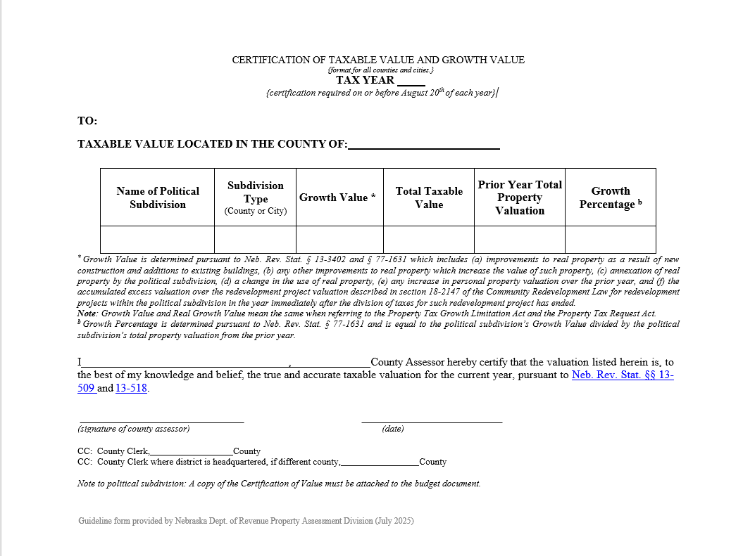
August 20th – Certifications of Taxable Values and Value Attributable to Growth delivered by County Assessor

Slide 20
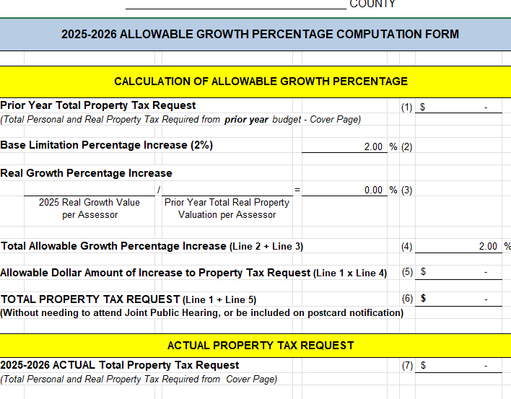
Joint Public Hearing: Yes or No?

Slide 21
By September 4^{th:} County Clerk or designee will choose date, time and location for joint public hearing
County Clerk will provide Assessor with date, time and
location of joint public hearing
County Clerk will publish notice of the hearing in a legal
newspaper in or of general circulation in the county.
County will post notice of the hearing on the home page of the county website if the county population is more than ten thousand.
County Board will designate the vendor that will provide
printing services. (MIPS and State Print Shop are available) Estimated cost per postcard is .60-.62 (printing, presort, postage).

Slide 22
By September 4^{th:} Publication and Website Requirements
County Assessor will provide the County Clerk with a list of all political subdivisions and locations, date and time of hearings for publication and notify each participating political subdivision of the date, time, and location of the joint public hearing.
Publication and website shall include the date, time, and location for the joint public hearing, a listing of and telephone number for each political subdivision that will be participating in the joint public hearing, and the amount of each participating political subdivision's property tax request. (include all joint public hearings that impact your county’s taxpayers).
Newspaper publication cost is not reimbursable

Slide 23
By September 4^{th:} Deadline for subdivisions to notify County Assessor
County Assessor will receive relevant information via email from the Political Subdivisions for the postcard.
As a reminder: Political Subdivisions not headquartered in county will need to report to the assessor in all counties where their taxpayers are impacted by the tax request increase.
It is the responsibility of the political subdivision to electronically submit information for the postcard to the county assessor(s) of all your taxpayers.
Use the nebraskacounties.org/directory to find county assessor emails

Slide 24
By September 4^{th:} Data for the Postcard
The location, date and time of the Public Hearing political subdivision is headquartered
Contact person, phone number and email address of political subdivision
Prior Year Total Taxable Value: Sum of all prior year certifications of taxable value
Current Year Total Taxable Value: Sum of all current year certifications of taxable value
Prior Year Property Tax Request
Current Year Property Tax Request
Updated Political Subdivision form is available on the MIPS portal

Slide 25
Proposed Budget on Website
Each participating political subdivision shall also maintain a prominently displayed and easily accessible link on the home page of the political subdivision's website to the political subdivision's proposed budget, except that this requirement shall not apply if the political subdivision is a county with a population of less than ten thousand inhabitants, a city with a population of less than one thousand inhabitants, or, for joint public hearings prior to January 1, 2024, a school district.

Slide 26
Postcard Notification
County Board selects printing company
Counties that designate CSG or State Print Shop – NACO will facilitate with software vendors
Anticipate a 24-to-48-hour weekday turnaround
Beware of Postal Delays
NACO will invoice counties for printing and postage
Pink cardstock will be used
Cost is estimated at .60-.62 a postcard
Send postcards to all affected tax-payers (Assessor) must be sent seven days prior to joint public hearing in their county.
When scheduling a JPH meeting, please allow enough time for postcards to be processed and delivered (especially where delivery is weekly)

Slide 27
Joint Public Hearing: After September 14th and prior to the 24th
County is responsible for organizing joint hearing (must be held after 6:00 p.m.)
Each participating subdivision must designate one person to attend the joint public hearing and one elected official will be in attendance.
Presentation(s) must be provided by a representative from each political subdivision about the increase in property tax request
Public must be allowed a reasonable amount of time to speak at joint public hearing
Meeting must be held before any participating subdivision files their adopted budget with the State Auditor
County may hold their regular budget meetings prior to the joint public hearing
Short Video to prepare for Joint Public Hearing https://vimeo.com/862091109

Slide 28
Joint Public Hearing Presentation:
The presentation shall include the following:
The name of the political subdivision
The amount of the property tax request
The total assessed value of property differs from last year's total assessed value by ..... Percent
The tax rate which would levy the same amount of property taxes as last year, when multiplied by the new total assessed value of property, would be $..... per $100 of assessed value
The (name of political subdivision) proposes to adopt a property tax request that will cause its tax rate to be $..... per $100 of assessed value
Based on the proposed property tax request and changes in other revenue the total operating budget of (name of political subdivision) will exceed last year's by ..... Percent
To obtain more information regarding the increase in the property tax request, citizens may contact the (name of political subdivision) at (telephone number and email address of political subdivision).

Slide 29
During the Joint Public Hearing:
At least one elected official from each participating political subdivision shall attend the joint public hearing.
An elected official may be the designated representative from a participating political subdivision.
The presence of a quorum or the participation of elected officials at the joint public hearing does not constitute a meeting as defined by section 84-1409 of the Open Meetings Act.

Slide 30
Submit Report Within 10 days of Joint Public Hearing:
The name(s) of the designated representative and the political subdivisions participating in the JPH.
The real growth value and real growth percentage for each participating political subdivision.
The amount each participating political subdivision seeks to increase its PTX in excess of the allowable growth %
The number of individuals who signed in to attend the joint public hearing.
Name and address of individuals that spoke at the hearing, unless the address requirement is waived to protect the security of the individual
The name of any organization represented by each such individual.
Name of participating subdivision that presented at the hearing
State Auditor has created a form and provided to County Clerks
State Auditor and NACO are requesting a copy of the report.

Slide 31
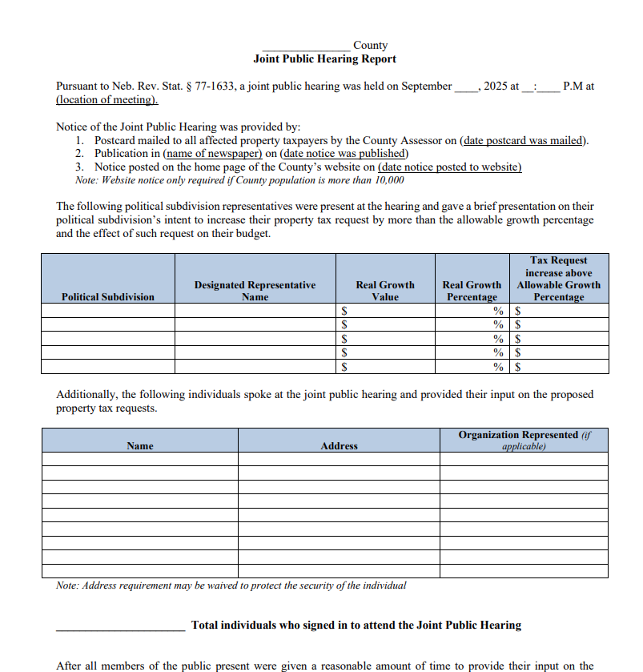
Submit Report Within 10 days of Joint Public Hearing:

Slide 32
After the Joint Public Hearing:
The governing body shall pass an ordinance or resolution to set the property tax request:
ORDINANCE or RESOLUTION MUST INCLUDE:
Name of the political subdivision
Amount of property tax request
Certain statements (following slide)
The record vote of the governing body in passing the resolution or ordinance.

Slide 33
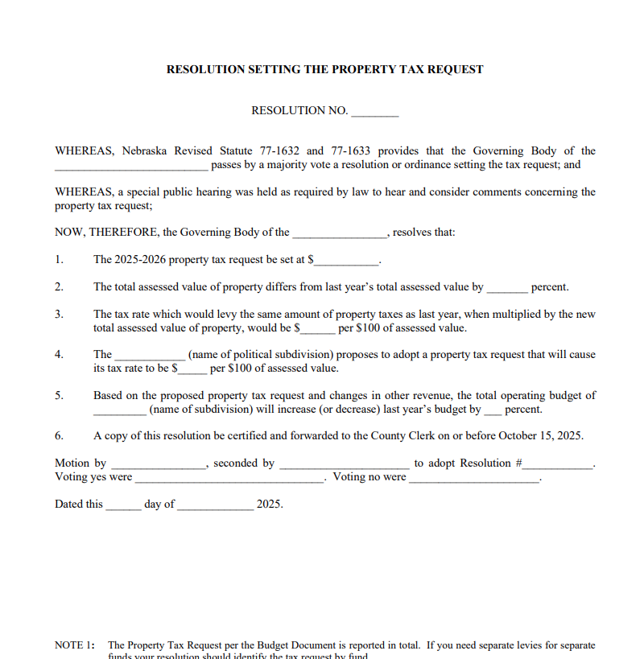
After the Joint Public Hearing Resolution/Ordinance Due to County Clerk by Oct. 15
Form available on APA Website.

Slide 34
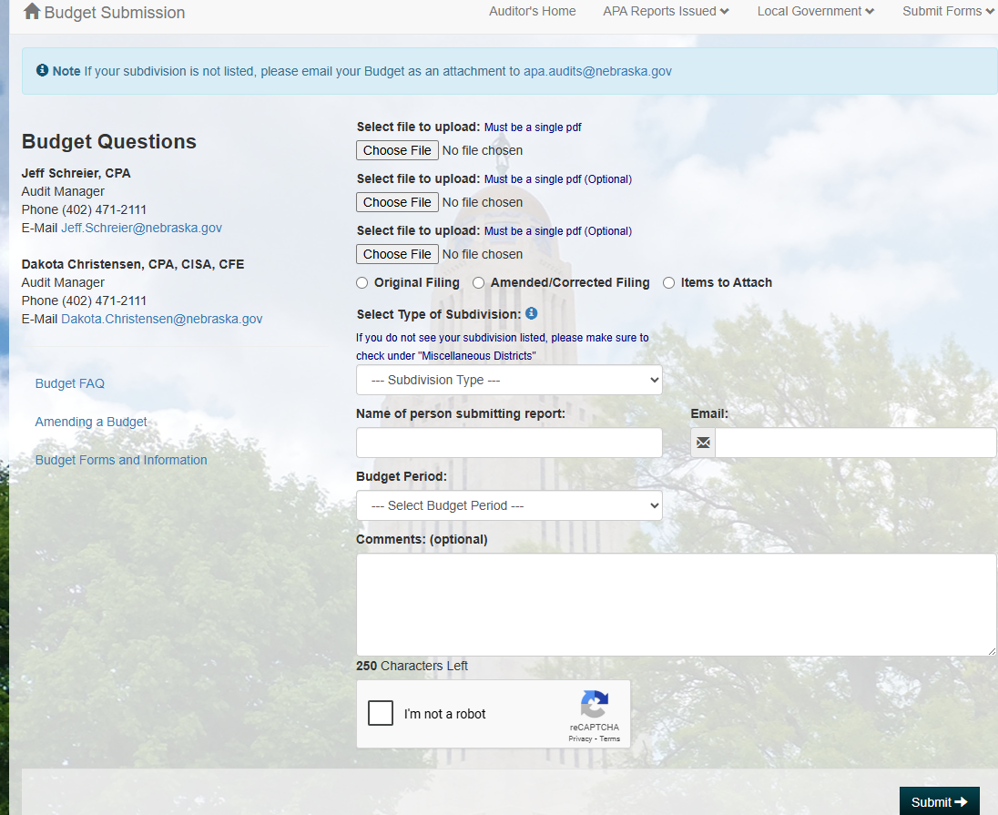
September 30th- Final day to file adopted budget to State Auditor

Slide 35
Cost Share for Postcards
The initial cost for Postcards, Printing, and Postage will be paid from the County General Fund
Cost of Postcards will divided proportionately among participating subdivisions.
The actual cost for the postcard is estimated at .60-.62 cents.
Counties that use MIPS Assessor software will receive a breakdown to assist with postcard reimbursement cost.

Slide 36
Timeline Snapshot
On or Before August 1 – political subdivisions submit preliminary request for levy allocation to county board
On or Before August 20- County Assessor certifies assessed value on all taxable property.
September 1- determine final allocation of levy authority for political subdivisions
September 4 – joint public hearing notices to Assessor
September 15-23 – joint public hearings
September 30 – Budgets must be submitted to APA
October 20- BOE certifies and sets levy for taxes

