Slide 1
NEBRASKA DEPARTMENT OF ECONOMIC DEVELOPMENT
Navigating the New World of Economic Development
June 4, 2025

Slide 2
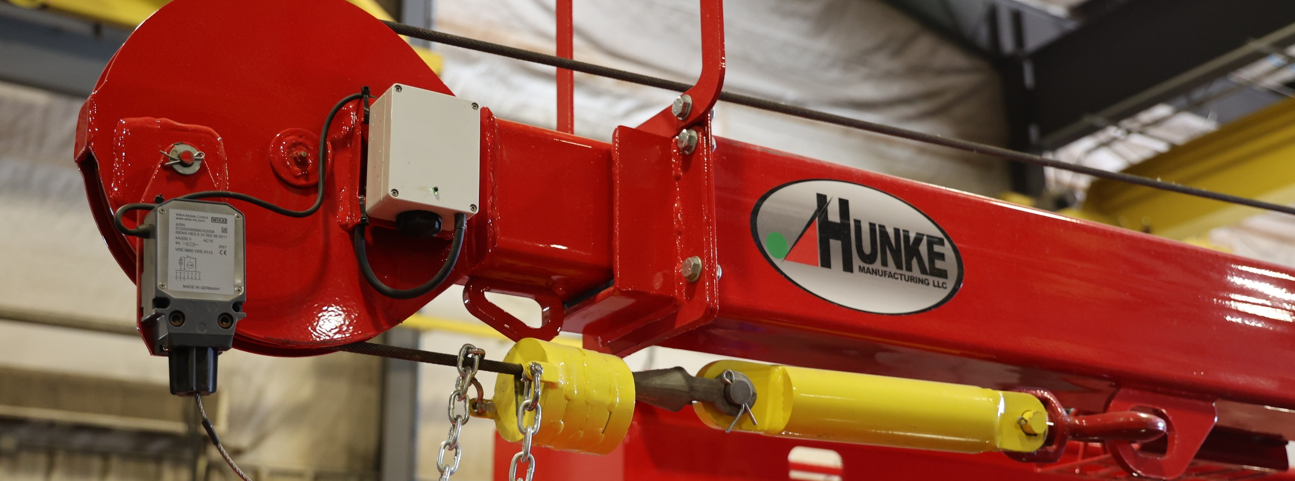
Celebrating Nebraska’s Successes
Increasing Population
Crossed 2 million in 2024
#2 Fastest-growing state in the Midwest
Growing Workforce
Record-high employment for 4 consecutive months

Slide 3
Celebrating Nebraska’s Successes
Industry Successes
Construction & tourism employment at all-time highs in 2024
Record beef exports in 2024
Manufacturing GDP up nearly 50% in 5 years.
Quality of Life
NE ranked #5 Best State by U.S. News - May 2025

Slide 4
A New Plan for Economic Development
Growing Our Own
People
Places
Entrepreneurs
Strategic & Targeted
Business Recruitment
Incentives

Slide 5
A New Paradigm for Economic Development
Economic Development = Workforce Development = Community Development

Slide 6
New Partnerships for Economic Development
Nurturing a Culture of Partnerships
Across state agencies & levels of govt.
Business
Non-Profits
6 Regions, One Nebraska
Notes:
BSB, DHHS, DOE, DOL, Aksarben, Invest

Slide 7
Workforce Development
Opportunities
3rd-highest % of the population under 18
5th-highest birth rate in America
BRAIN GAIN among first-year college students
More students come to Nebraska for college than leave Nebraska for college
More tourism than ever before

Slide 8
Talent Attraction
In-State Initiatives
READ Nebraska Mentoring Program
Historic K-12 education funding
Partnerships to grow the trades

Slide 9
Talent Attraction
Out-of-State Initiatives
Good Life Is Calling
Targeted
Data-driven
Model of partnership

Slide 10
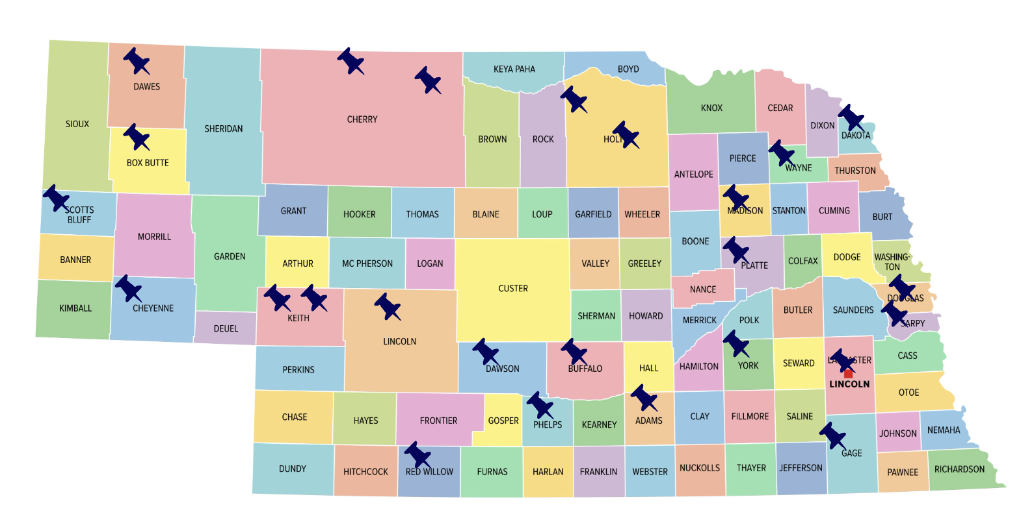
Immersion Tour & Focus Groups Overview
Representing
33
Focus Groups & Meetings​
43% Local
32% Transplant
25% Boomerang
25
Communities Visited
Notes:
SLIDE 10

Slide 11
More than half of respondents say they would like to stay in Nebraska after graduation, mainly due to cost of living.
NEBRASKA STUDENTS
Q: Once you finish your educational program/degree in Nebraska, where are you most interested in living?
Q: What are the primary reasons you would stay in Nebraska after completing your educational program/degree? (choose all that apply)
Notes:
SLIDE 11

Slide 12
A job opportunity will influence where students choose to relocate to following graduation.
NEBRASKA STUDENTS
Q: Following graduation, would you consider moving to a new location without a job opportunity lined up?
Q: Following graduation, if a job meeting your skill and salary requirements were offered to you in Nebraska, would you be willing to accept it?
Notes:
SLIDE 12

Slide 13
44% of respondents would like to move out of Nebraska and of those, 6 in 10 feel it is likely they will move.
INTERNAL TALENT
Q: On a scale from 1 (not at all) to 10 (very much), how much do you want to leave Nebraska and relocate somewhere else within the next two years?
Q: On a scale from 1 (not at all likely) to 10 (extremely likely), how likely is it that you will leave Nebraska and relocate somewhere else in the next two years?
Notes:
SLIDE 13

Slide 14
There are positive perceptions of Nebraska as a place to raise a family and live but career-related factors are less positively perceived.
INTERNAL TALENT
Q: Based on your experience or general perceptions, how would you rate Nebraska as a place to…? (1=poor, 10=excellent)
Notes:
SLIDE 14

Slide 15
Cost of living, housing costs/ availability and safety are “must haves” for talent considering a relocation.
EXTERNAL TALENT
Q: Please rate the importance of the following quality of life factors if you were considering relocating to a new area more than 100 miles from your current location. (1=not important, 10=most important)
Notes:
SLIDE 15

Slide 16
Nebraska receives strong scores on some of talent’s top “must have” factors
EXTERNAL TALENT
Q: To the best of your ability, please rate Nebraska on the following quality of life factors. (1=poor, 10=excellent)
Notes:
SLIDE 16

Slide 17
Quality of Life Factors: Importance vs. Nebraska Ratings
EXTERNAL TALENT
SELECTIVELY MARKET
ACTIVELY MARKET
A | A "cool" factor
B | Arts/cultural amenities
C | Availability of childcare
D | Climate/weather
E | Cost of living
F | Diverse population
G | Housing availability
H | Housing cost
I | Live/work/play in one location without long commute
J | Nightlife/active social scene
K | Outdoor recreational opportunities
L | Political/social climate supports my beliefs and values
M | Proximity to family
N | Quality healthcare
O | Quality of K-12 education system
P | Safety/crime rates
Q | Welcoming/friendly local population
IMPROVE / IMPROVE MARKETING
Basic need
Attitudinal
Product
Dotted lines denote overall averages.
Notes:
SLIDE 17

Slide 18
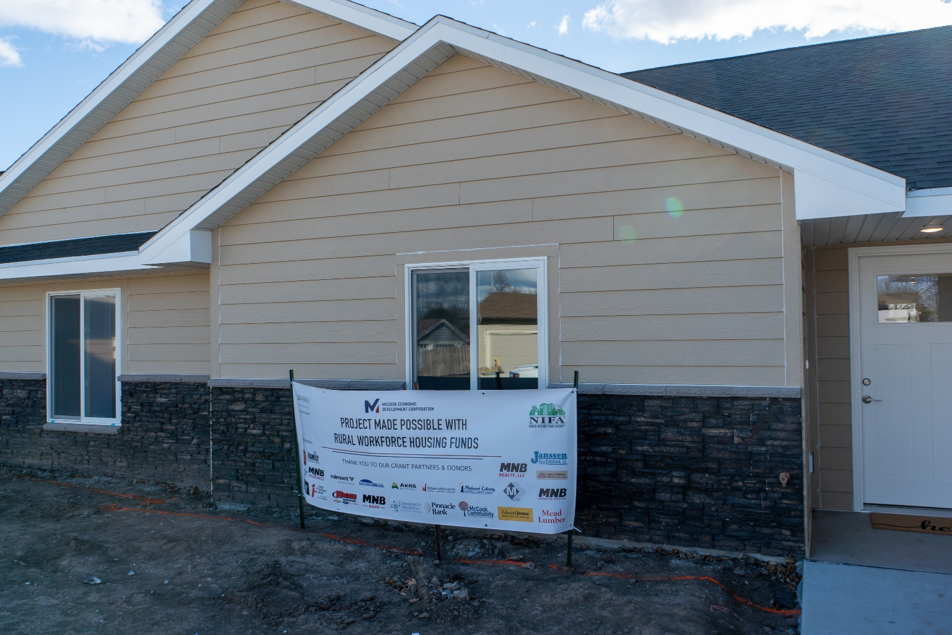
Community Development: Housing
Attacking the Housing Shortage:
Strategic investments in housing development
Expediting awarded funds for projects

Slide 19
Community Development: Placemaking
Making Our Communities Magnets for Talent:
Community Development Block Grants
Community and Civic Center Financing Fund
Notes:
McCook Pool

Slide 20
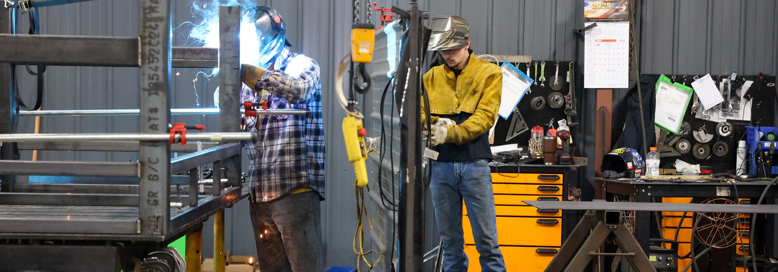
Business Development
Creating a Statewide Ecosystem
for Entrepreneurs
Challenge: Convene & Connect
Abundance of great programs, but…
Disconnected from one another
Disconnected to entrepreneurs

Slide 21
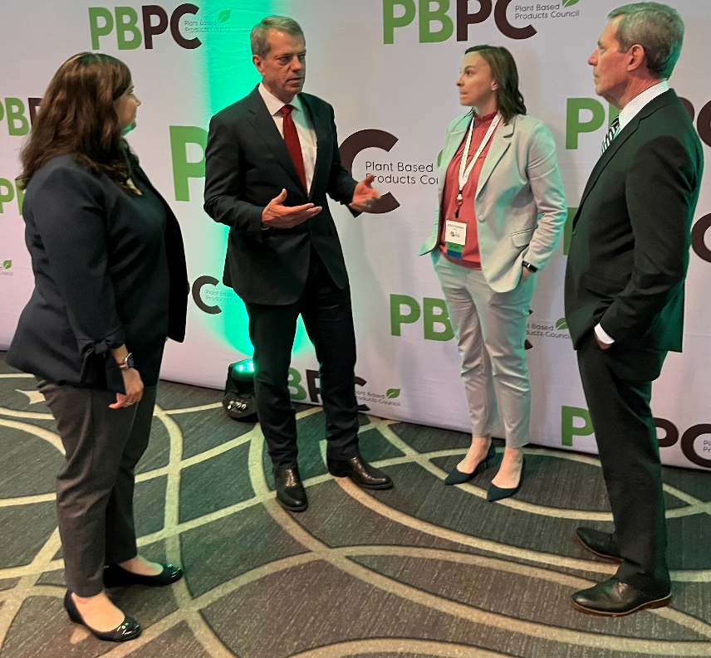
Business Development: Bioeconomy
Nebraska’s Advantages
Agriculture powerhouse
Sustainable, prolific production
Abundant natural resources
Ag tech hub
World-class ag research
Reliable, affordable energy
Central location

Slide 22
Nebraska’s Window of Opportunity
We have a historic opportunity to change the trajectory of our state!
Young population
Quality of life that talent is seeking
Thriving industries

Slide 23
Q&A

