Slide 1
Nebraska Emergency Management Agency
Communications Systems Overview

Slide 2
2026 Spring Wildfires

Slide 3
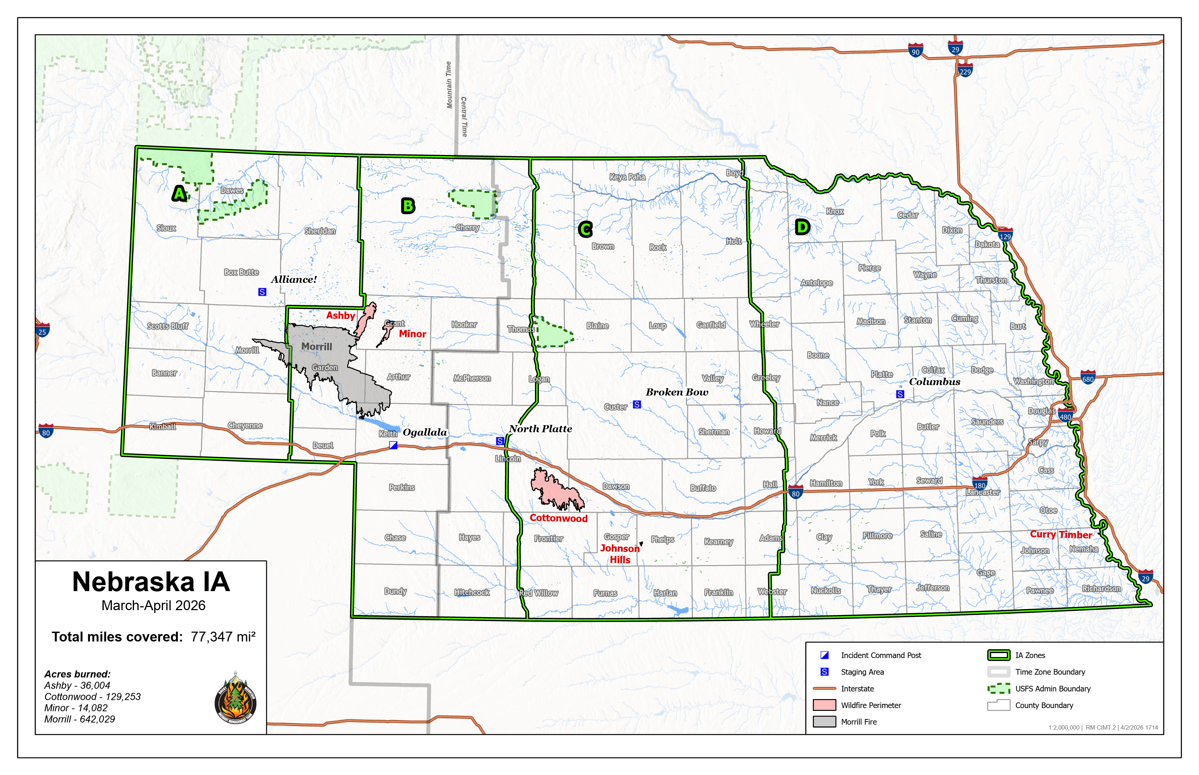
2026 Spring Wildfires

Slide 4
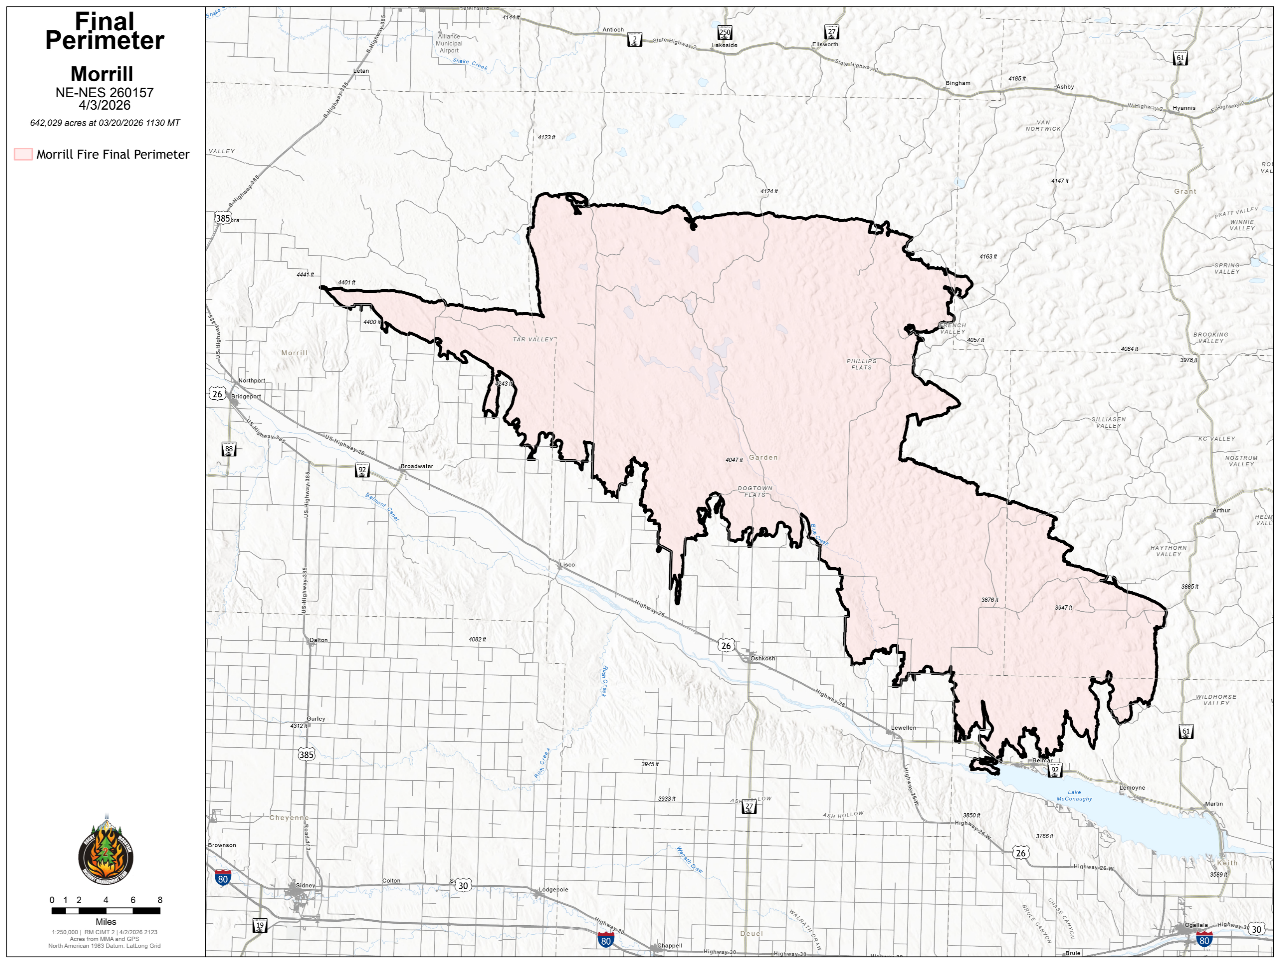
Morrill Fire
Final Acres Burned: 642,029
Terrain: Rolling grass covered sandhills
Communications Challenges
  Limited Coverage
    Existing Systems / Cellular
  Lack Equipment
    Ageing
    Funding
  Distances involved
  No good high points
  Speed of fire
Notes:
1003 Square Miles (Land mass of Rhode Island is 1545)
IC Ogallala
Ogallala to Bridgeport 88 miles
Ogallala to Ashby 79 miles
NIFC Antenna on existing tower – local communications company

Slide 5
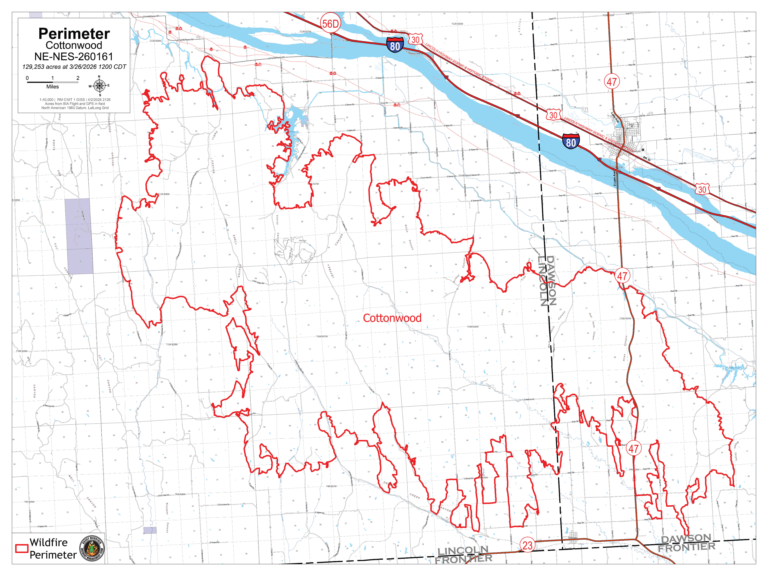
Cottonwood Fire
Final Acres Burned: 129,253
Terrain: Hills/Valleys with cedar trees
Communications Challenges
  Distances involved
  Narrow deep valleys
Notes:
1003 Square Miles (Land mass of Rhode Island is 1545)
Narrow deep valleys hard to cover
CIMT installed 2 linked command repeaters
“Human Repeater” on top of some hills needed

Slide 6
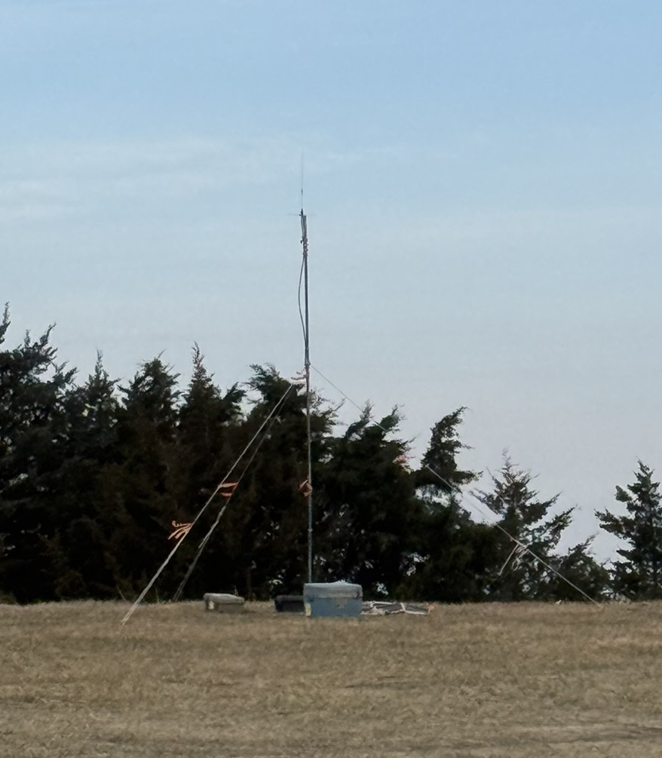
Complex Incident Management Team (CIMT)
Communications
Primary Radio System
  NIFC Cache Radio / Repeaters
    Installed repeater on local tower
  Starlink
Command moved from Ogallala to North Platte, then back
Incident Dispatch moved from Ogallala to Gothenburg, then back

Slide 7
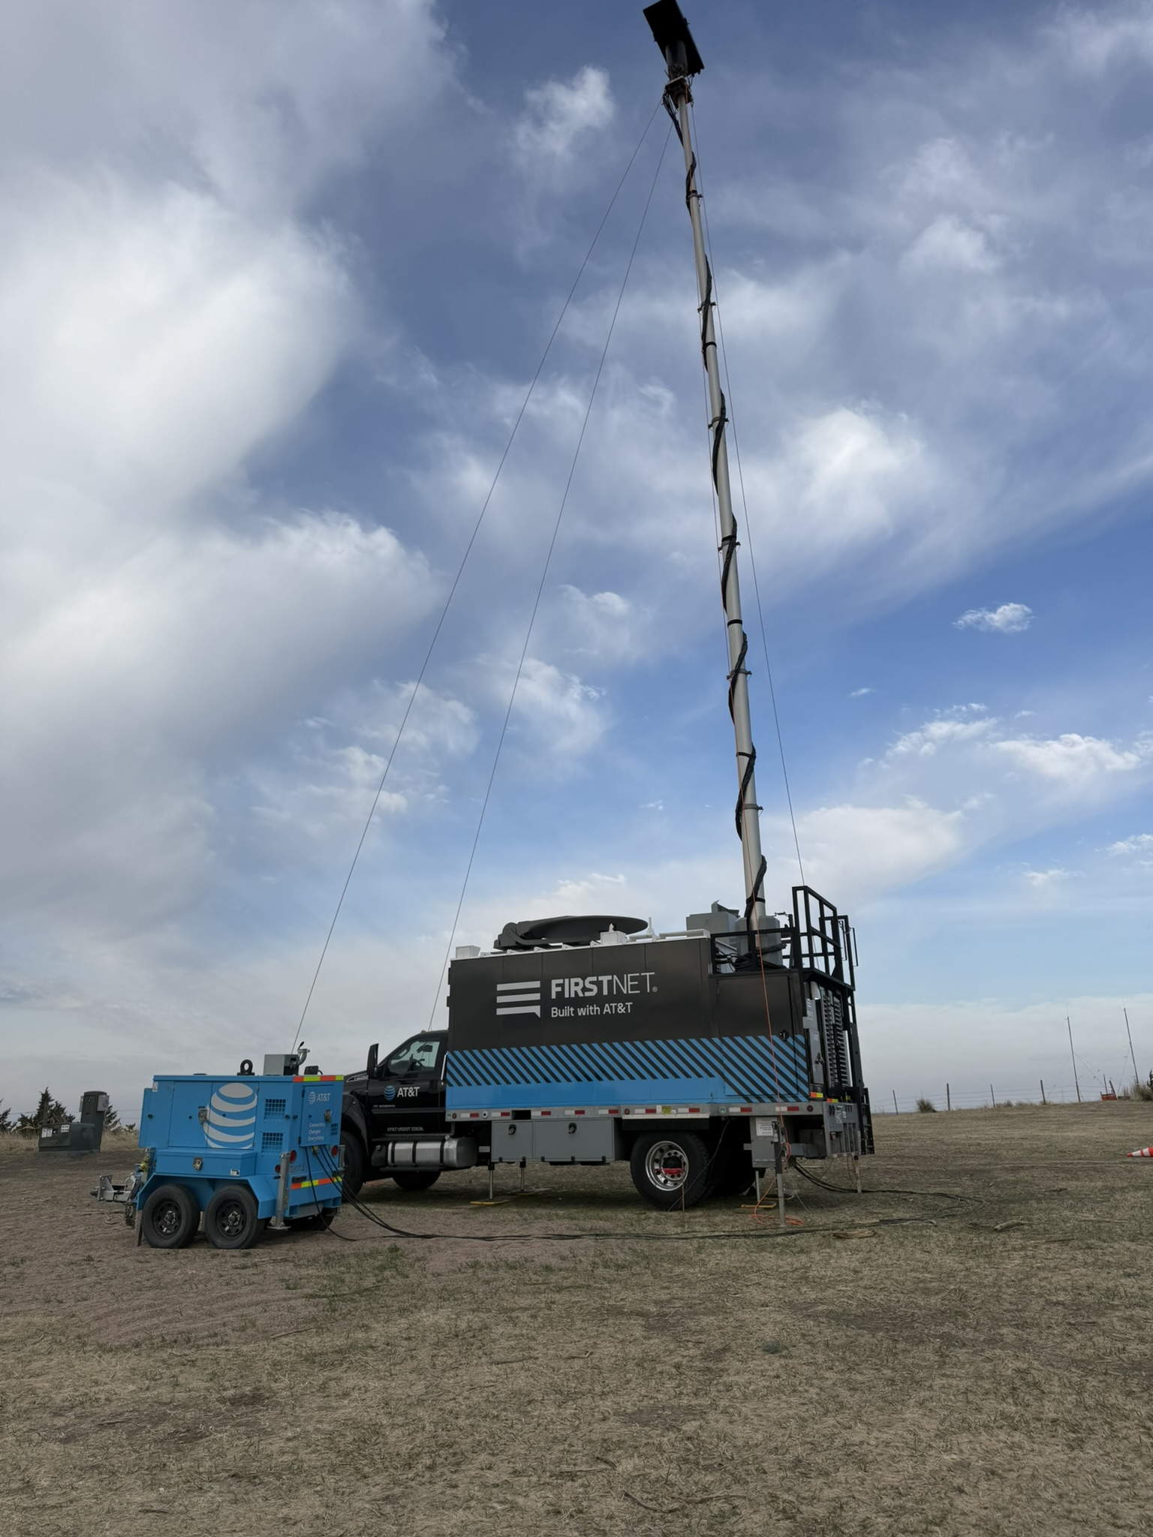
FirstNet
Local EM Requested SOW
  Tried to use Mission Critical PTT but too complex to setup on scene
Notes:
Mission critical PTT – application on phone to use as a radio. Did not work.

Slide 8
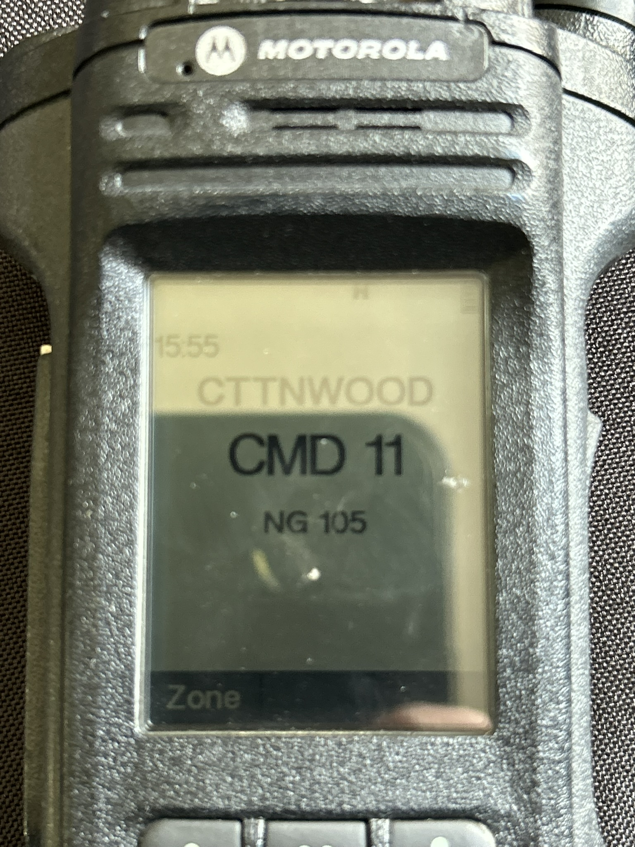
State Provided Resources
Cache Radio (1st Batch)
  Programming Error
  Fixed after discovery – NDOT
Cache Radio (2nd Batch)
State COMU Trailer
  Dispatch Console
  ICRI Gateway
OCIO
NEMA
Notes:
ICRI Gateway – connect multiple radio systems

Slide 9
Statewide Initial Attack
CIMT responsible for IA
Hybrid Communications
  State Radio System for Command
  NIFC Radio for inter-team
  NIFOG Channels for interoperability
  Starlink
    Data/Coms as needed
  Cellular backup
Notes:
Teams staged in Alliance, Ogallala (ICP and Helicopter Base), Broken Bow, Columbus
NIFC – National Interagency Fire Center
NIFOG – National Interoperability Field Operations Guide. Frequencies published in this guide should be programmed into radios to allow for interoperability.

Slide 10
Questions

