Slide 1
Emerging Trends of Substance Misuse.
Are You Prepared?
Hamilton Baiden, CEO, Youturn Health
June 13, 2024

Slide 2

Hamilton Baiden
CEO, Youturn Health
With almost three decades of experience in the healthcare industry, Hamilton brings both a vision and passion for creating innovative solutions to complex problems. He has been the driving force behind expanding the behavioral health services that Youturn Health offers and leveraged his experience and entrepreneurial spirit into creating progressive programs.
As CEO, Hamilton focuses on providing transparent leadership and expanding upon Youturn Health’s vast portfolio of services and solutions; his strategic direction and initiatives will cement Youturn Health’s status as one of the industry’s top Integrated Health Care Managers. Hamilton’s extensive knowledge of the industry will also lend itself to developing new healthcare solutions and services within the Youturn Health brand.
2

Slide 3
Addiction and Substance Misuse

Slide 4
Defining the Problem
9.6%
1 in 7 (or 14.3%)
of the workforce suffer from substance use disorders
(SAMHSA)
Americans has a substance use disorder (SAMHSA)
5x
90%
Loved ones of people struggling with addiction are 5x more likely to use emergency services (Schneider Health Institute)
of suicides are carried out by someone with depression, struggling with substance misuse, or a combination of both (Addiction Center)
46%
26%
of Americans have a meaningful relationship with someone struggling with addiction have struggled with it personally
(Pew Research Center)
of employees reside in homes where addiction is present
(Addiction Center)
Notes:
Sources:
9.6% of workforce suffers from SUD: SAMHSA. The NSDUH Report, 10.8 Million Full-Time Workers Have a Substance Use Disorder. https://www.samhsa.gov/data/sites/default/files/NSDUH-SP132-FullTime-2014/NSDUH-SP132-FullTime-2014.pdf
46% of Americans either struggle with SUD or have a relationship with someone who does: Pew Research Center: https://www.pewresearch.org/politics/2017/10/24/10-financial-well-being-personal-characteristics-and-lifestyles-of-the-political-typology/#drug-addiction-has-impacted-gop-and-democratic-groups-alike.
1 in 7 Americans has SUD: SAMHSA: https://www.samhsa.gov/data/sites/default/files/reports/rpt35325/NSDUHFFRPDFWHTMLFiles2020/2020NSDUHFFR1PDFW102121.pdf
90% of suicides are carried out by someone with depression, substance misuse, or a combination: Addiction Center: https://www.addictioncenter.com/addiction/addiction-and-suicide/#:~:text=More%20than%2090%25%20of%20people,too%20often%20leads%20to%20suicide.
26% of employees go home to addiction: Addiction Center: https://www.addictioncenter.com/addiction/workplace

Slide 5
Addiction vs. Substance Misuse
Addiction is defined as a chronic, relapsing disorder characterized by compulsive substance seeking and use despite adverse consequences. It is considered a brain disorder because it involves functional changes to brain circuits involved in reward, stress, and self-control, and those changes may last a long time after a person has stopped taking drugs. (NIH)
Substance misuse (and dependence) are defined on a scale that measures the time and degree of substance use. Essentially, misuse is like the early stage of dependence. As substance misuse becomes more frequent, the likelihood of developing a dependence disorder becomes greater. (Addiction Center)
90%
of people who need help with alcohol
or drugs, don’t receive help
(SAMHSA)

Slide 6
What Addiction is NOT
Challenging some basic “truths” that are unfounded and inhumane
A Moral Weakness
A Character Flaw
A Personal Choice
A Criminal Offense
An Issue for Other People
6

Slide 7
Continuum of Substance Use
Never Used
No Current Use
Non-Risky Use
Risky Use
Addiction
(Substance Use)
(Substance Misuse)

Slide 8
Continuum of Substance Use
Never Used
12.7%
No Current Use
25.2%
Non-Risky Use
14.5%
Risky Use
31.7%
Addiction
15.9%
Percent of Population Age 12+ by Level of Substance Use*
(Substance Use)
(Substance Misuse)
Early intervention
47.6% of people 12 and over are misusing substances
*Includes tobacco, alcohol, illicit drugs, and misuse of controlled prescription drugs.
Source: CASAColumbia® analysis of The National Survey on Drug Use and Health (NSDUH), 2010.

Slide 9
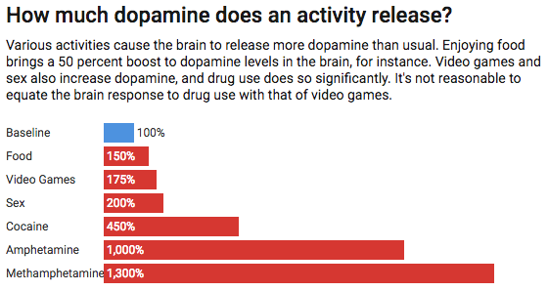
How Much Dopamine Does an Activity Release?
Various activities cause the brain to release more dopamine than usual. Enjoying food brings a 50 percent boost to dopamine levels in the brain, for instance. Video games and sex also increase dopamine, and drug use does so significantly. It’s not reasonable to equate the brain response to drug use with that of video games.

Slide 10
16
S
U
B
S
T
A
N
C
E
12
S
U
B
S
T
A
N
C
E
“Normal Baseline”=10
B
A
S
E
8
8
S
U
B
S
T
A
N
C
E
B
A
S
E
6
6
S
U
B
S
T
A
N
C
E
B
A
S
E
4
B
A
S
E
2
2
1

Slide 11
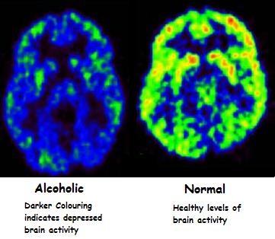
A Brain Disease
Chronic Substance Use—Substance Use Disorder Severe. Happens over time dependent on substance, hereditary issues, age of first use.
No chronic use of substances. Healthy brain.

Slide 12
SUD DSM-5 Criteria
Severe=6 or More | Moderate 4-5 | Mild 2-3
Heavy use, partying, “had a bad night”
Crossing line into addiction
Tolerance
Withdrawal
Craving/preoccupation
Can’t control
Can’t cut back
Interpersonal issues
Avoid non-using activities
Great deal of time spent on using
Use despite physical/psychological dangers
Use in physically hazardous situations
Role failure due to use
Age onset, frequency,
Drug specific
Reward potential
Genetic factors

Slide 13




Who Addiction Affects
Family
Friends
Common patterns emerge within families where at least one individual is addicted to drugs. These patterns include high levels of criticism within household, parental inconsistency, or in the case of parents coping with a drug-addicted child, denial.
Addiction changes the personality of the addict which in turns changes the dynamic of your friendship. Instead of just hanging out with friends, it will place the subtext of time together on those changes that addiction did to the addict. To some, this added struggle will be too much to cope with.

Slide 14
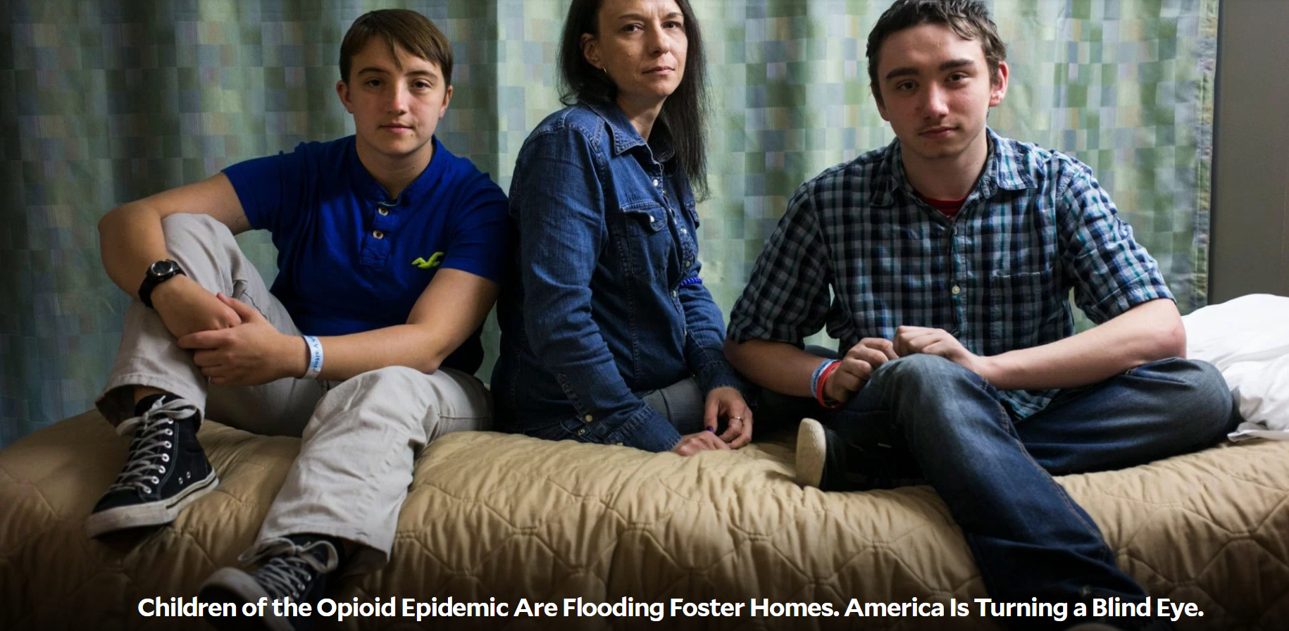
Who Addiction Affects

Slide 15




Who Addiction Affects
Employers
Employees
A loss in productivity affects employers directly. If substance use is rampant, it can result in loss of the revenue. Estimates suggest working users are one-third less productive than their non using co-workers. Also, working while under the influence of substances increases the risk of workplace related injury, resulting in increased insurance premiums.
Co-workers of employees struggling with substances take on additional responsibilities at work to accommodate the increases in presenteeism (present but not productive) and absenteeism. Co-workers overcompensate by working longer hours to cover employees struggling with substance use which can result in burnout.
15

Slide 16



Risk Mitigation
Substance Use Disorders (SUDs) impact EVERY company. It manifests as stress, anxiety, and depression.
Organizations need employ risk mitigation strategies to reduce the chance of an incident.
Most sexual harassment, sexual assault, and workers’ comp claims are tied to drugs and alcohol
Employment Practices Liability deductibles are triggered in settlements

Slide 17
For claims filed for injuries occurring between October 1, 2012 and September 30, 2013, with prescriptions filled through the end of March 2015:
Worker’s Comp Claims
Between 65–75% of injured workers received opioids in most of the studied states
Outlier states at the high end included Arkansas (85%), Louisiana (80%), and South Carolina (80%)
At the low-end: New Jersey (52%) and Illinois (56%). California was high in the bottom third, coming in at about 66%.

Slide 18

Recognizing Substance Misuse Behaviors in the Workplace

Slide 19
Signs and Symptoms of Workplace Impairment
Signs of Physical Impairment
Rapid shift in physical appearance
Tremors
Unsteady gait or lack of coordination
Delayed reaction time
Odor of alcohol or drugs
Direct observation of substance use
Lack of energy or chronic weariness
Loss of consciousness
Signs of Cognitive Impairment
Inappropriate verbal or emotional responses
Irritability
Memory loss
Inappropriate or abnormal behavior
Isolation
Lack of concentration, confusion, forgetfulness
Distraction
Signs of Performance Impairment
Frequently calling out sick
Unexplained tardiness, early departure, extended breaks
Errors in judgement
Decreased concentration and vigilance
Deterioration in performance or quality of work
Testing positive on a drug screen or impairment detection test
Loss of ability to do a skilled task

Slide 20
Expectation
Substance Misuse Behaviors
Reality
Physical
Skin changes
Sudden changes in weight
Hygiene
Dental issues
Change in sleeping habits
Emotional
Increased aggression
Depression
Lethargy
Changes in attitude or personality
Changes in habits or priorities
Physical
Nothing noticeable
Emotional
Nothing noticeable
vs

Slide 21
Staggering Statistics
“A record-breaking 105,000 people died of an overdose last year in the midst of the COVID-19 pandemic, the U.S. government reported...” ¹
Translates to an average of more than 250 people dying each day, or roughly 12 every hour
The odds of dying from an opioid overdose are now greater than those of dying in a car crash.
NSC survey shows that 75% of workplaces are impacted by opioid use.
75% of people with a Substance Use Disorder are in the workforce
21

Slide 22
The Impact of Substance Misuse

Slide 23
Percentage of Employees Who Lost 10% Hours of Productivity Per Week Due to:
Mental Health
Substance Misuse
58% (pre-pandemic)
55% of workers say a mental health issue has affected them more since the pandemic began
Substance Misuse
57% (during pandemic)
36% of workers say an addiction or substance Misuse issue has affected them more since the pandemic began
Mental Health
65% (during pandemic)

Slide 24
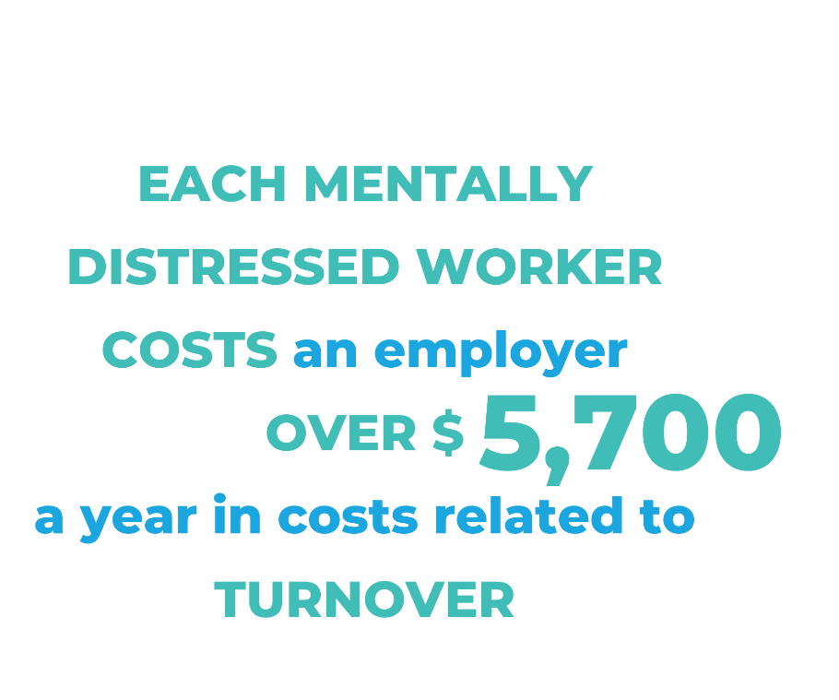
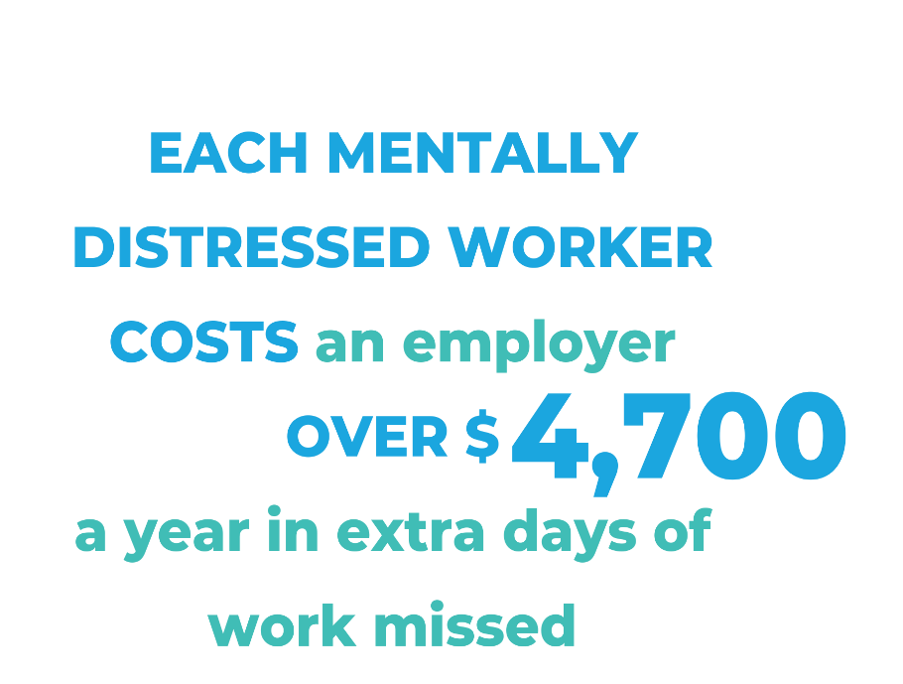
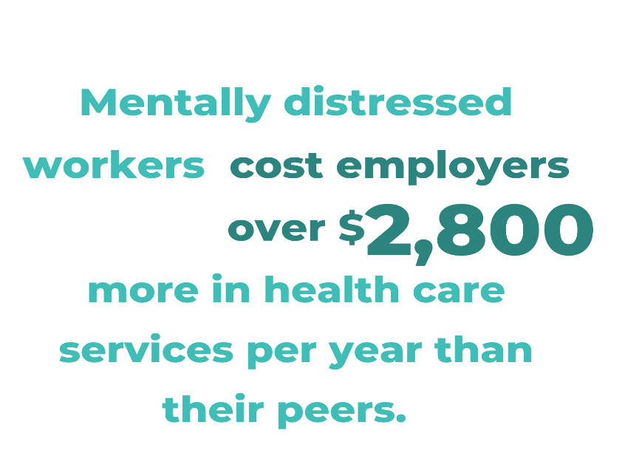
Employer Impact
Employers spend, on average, over $15,000 more a year on employees who experience mental distress
*Statistics According to the National Safety Council
Notes:
On average, per employee annually.
Low prevalence occupations include executive/administrative/managerial/financial, protective services and construction.
Occupations with high levels of distress include: entertainment, sports, media and communications, and technicians and related support occupations.
Employees who have experienced mental distress in the past year are more likely to have reported driving under the influence of alcohol or other drugs

Slide 25
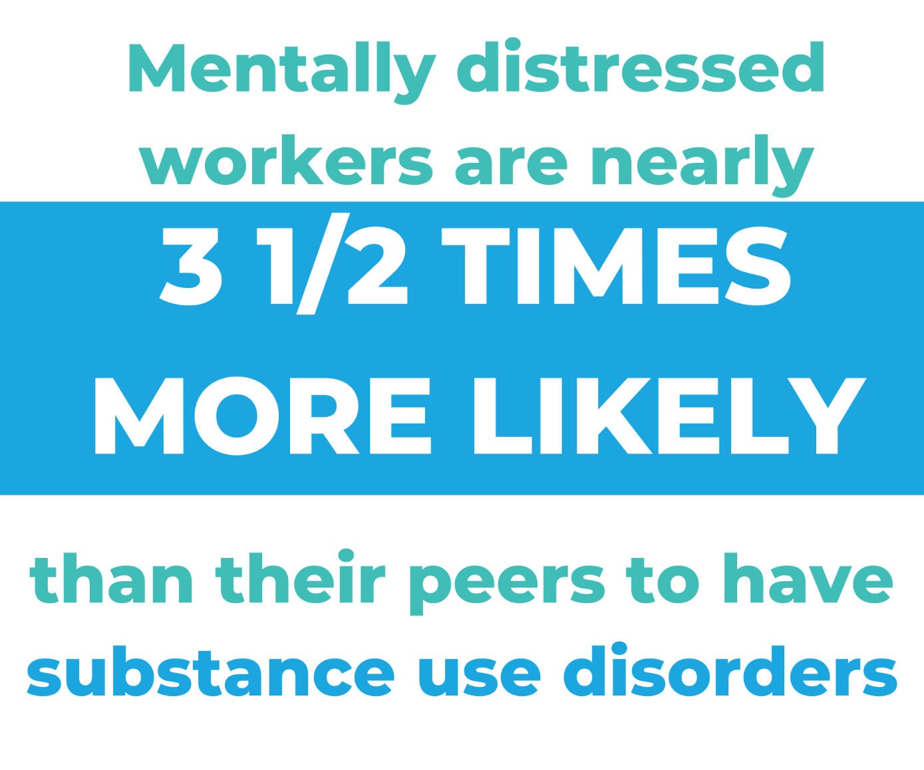
Employee Impact
*Statistics According to the National Safety Council

Slide 26
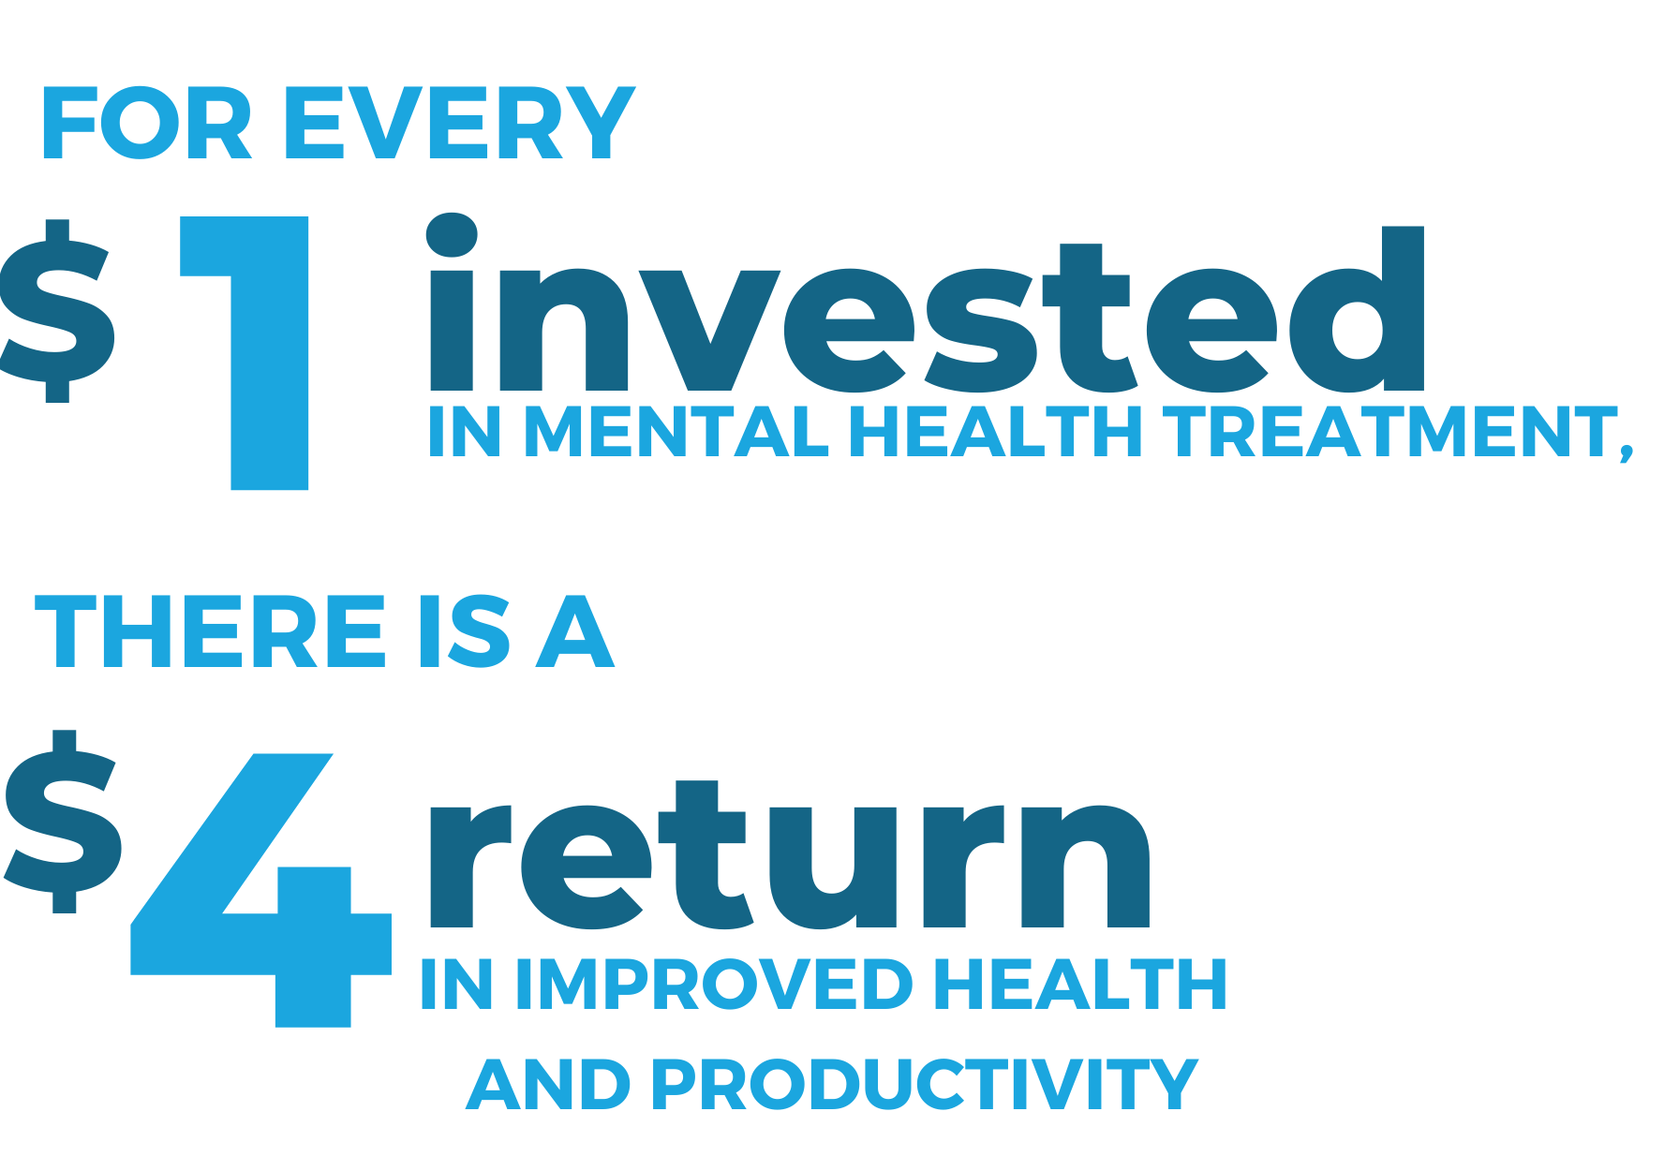
Supporting Mental Health — Worth It!
*Statistics According to the National Safety Council

Slide 27
How do We solve this Problem!!!

Slide 28

Gaps in the Treatment of Addiction
Only 10% of Individuals ever reach out for help
  What about the 90% that are struggling that will never receive traditional treatment?
Family support is lacking or nonexistent
  Support often centers on the individual (which makes sense), but family support is a crucial element that is often overlooked.
Engagement
  We know that 75% of people that remain engaged (no matter what the treatment is) reach recovery or remission. The problem is figuring out ways to reach those who do not remain committed and engaged.

Slide 29


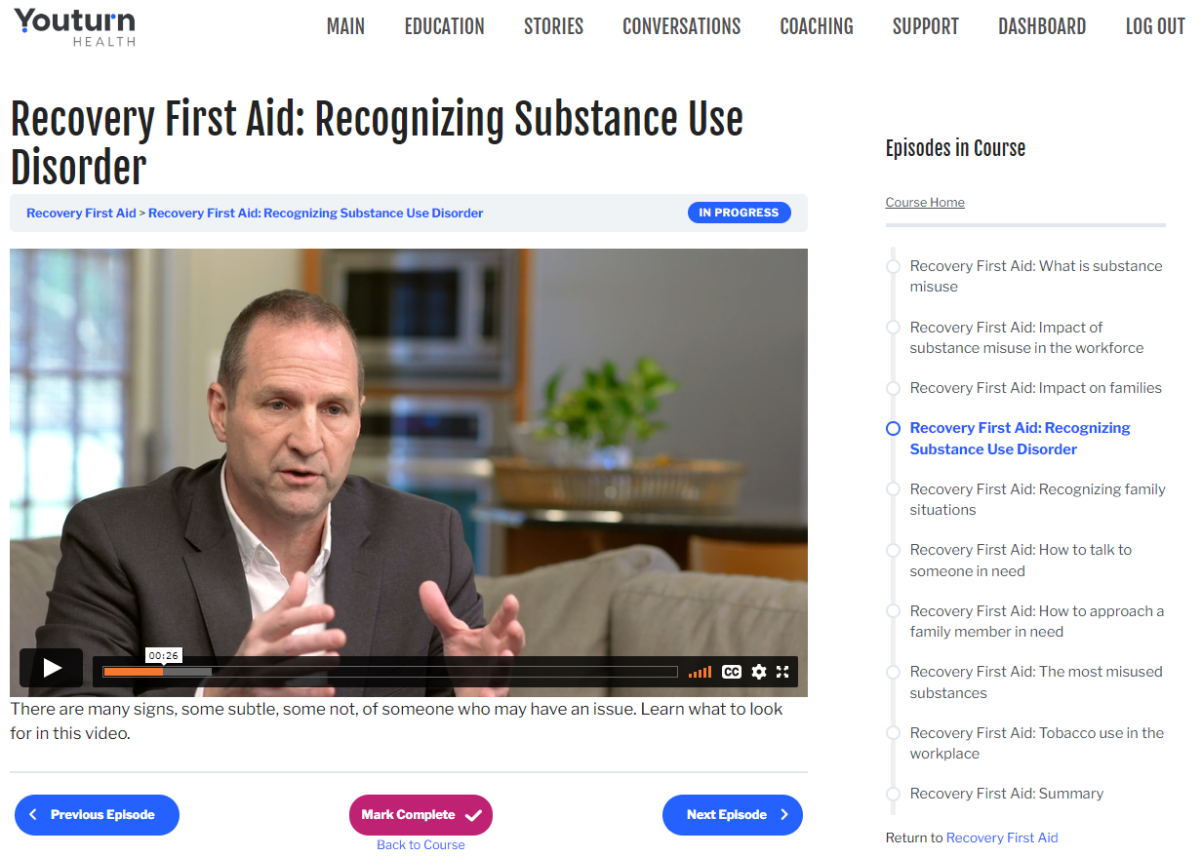
Engagement
youturn is an online learning management system that contains the most extensive collection of video content about substance abuse. It provides confidential support to individuals struggling with addiction and suicidal ideations through targeted video series that uses education and live conversations with real people to aid in the journey to recovery.
This presentation contains confidential and proprietary information and may not be shared or distributed without the written consent of Youturn Health. Confidential © 2022 Youturn Health, Inc. All rights reserved.
13

Slide 30

Peer Support Network
Certified Professionals
State-certified ACE coaches are NAADAC-trained and understand maintaining a high level of engagement will achieve recovery goals, while leveraging their own lived experience to deliver effective, compassionate support.
Accomplish Recovery Goals
Harm reduction and motivational interviewing are the foundation for all coaching activities. Integration of family and community programs into the recovery planning process is provided to clients and their families.
Develop New Behaviors
Proactive coach outreach helps maintain a positive outlook on the recovery journey by developing new behaviors and increasing social support which will sustain accountability.

Slide 31
Assertive Community Engagement
Meet the participant Wherever they are in this journey
Refer for Clinical Support
Stick and Stay
Paradigm Shift: The Professional is responsible for the
Engagement of the Participant
This presentation contains confidential and proprietary information and may not be shared or distributed without the written consent of Youturn Health. Confidential © 2022 Youturn Health, Inc. All rights reserved.

Slide 32
Family, friends, and co-workers, and by extension the community, are our one best shot at ending this addiction epidemic. It is an attached and empowered family that will win the day.
Professional family coaches are a key part of that equation.

Slide 33
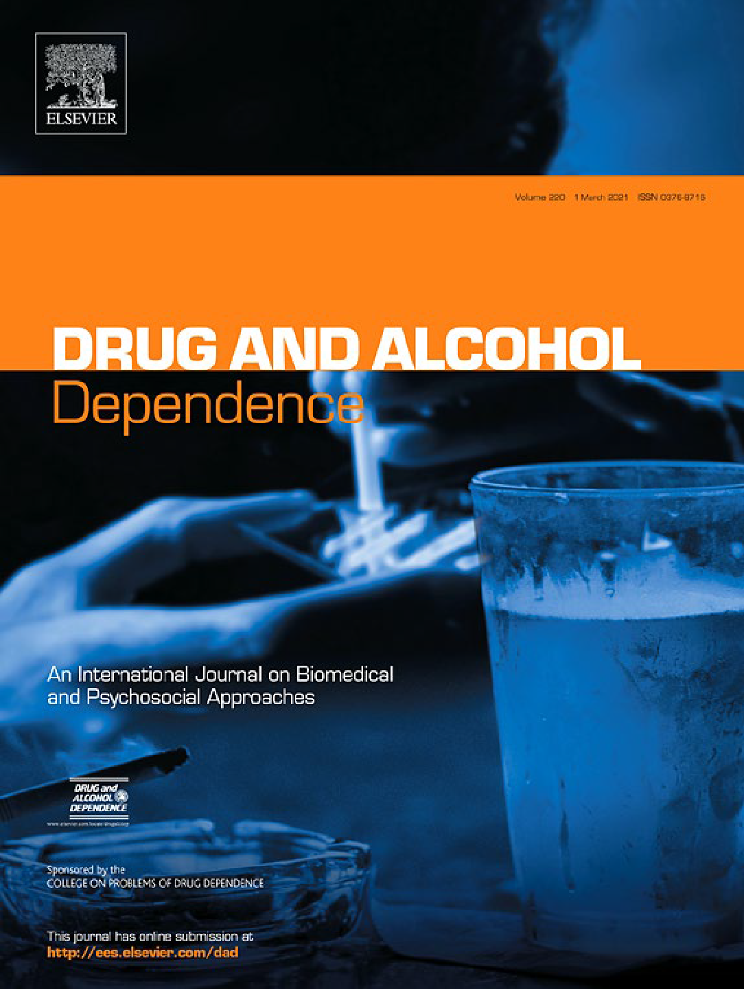
Inpatient Link to Peer Recovery Coaching:
Results from a Pilot Randomized Control Trial
Results
Engagement rate over the six-month post-discharge time period was higher for participants in the recovery coaching intervention (84%, 95% CI: 78% to 91%) compared to the standard of care control condition (34%, 95% CI: 25% to 44%), log OR = 28.95, p<.001.
Conclusion
SUD is a chronic, relapse-prone disease, and the most important factor for predicting improvement at five years post-discharge is on-going engagement (Weisner et al, 2003). This study demonstrates that inpatient linkage to recover coaching services improves engagement rates and can feasibly be implemented in a single large hospital system. This intervention is promising for both short-term and long-term engagement in recovery support services.
Kaileigh A. Byrne, Prerana J. Roth, Krupa Merchant, Bryana Baginksi, Katie Robinson, Katy Dumas, James Collie, Benjamin Ramsey, Jen Cull, Leah Cooper, Matthew Churitch, Lior Rennert, Moonseong Heo, & Richard Jones
Clemson University, Prisma Health-Upstate, University of South Carolina School of Medicine Greenville

Slide 34


Percentage of Participants Engaged in Recovery
Care Services by Condition: All Participants
1
0.9
0.8
0.7
0.6
0.5
Engagement Percentage
Intervention
0.4
Control
0.3
0.2
0.1
0
Baseline
30-Day
60-Day
90-Day
6-Month
Time Point

Slide 35

Peer Intervention to Link Overdose Survivors to Treatment
Study in Development
Project Overview
Summary: This project is a 3-site, randomized controlled trial using Peer Recovery Coaches trained in FORCE (FAVOR Overdose Recovery Coaching Evaluation).
Engagement Plan: Coaches will engage with opioid overdose survivors in the emergency department and follow a modified FORCE manual using a tiered approach of engagement, utilizing motivational interviewing and a strengths-based care management approach to engage participants in care and develop a patient-centered recovery plan.
Intervention Duration: The FORCE intervention will be tailored to the participant's needs and will continue for 12 months after enrollment.
Integration and Referral: This intervention will be compared to Treatment as Usual (TAU) in which overdose survivors receive referral to treatment.
Anticipated Results: Outcomes include engagement in formal OUD treatment between groups, retention in treatment, and number of overdoses after enrollment.
The ACE model has been adopted by the National Institute of Drug Abuse (NIDA) Clinical Trial Network (CTN)​
The NIDA CTN is the federal government’s program to identify and promote evidence-based programs​
The first peer recovery model to be included in the Clinical Trial Network​

Slide 36
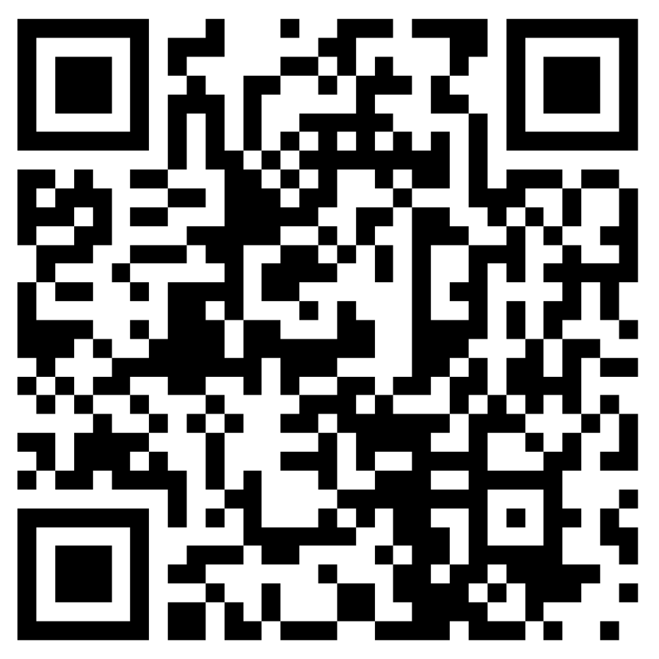
Contact Us For More Information
About Youturn Health

Slide 37



Thank you!
Questions?
Hamilton Baiden
CEO
Youturn Health
hbaiden@youturnhealth.com
youturnhealth.com
youturnhealth
youturnhealth
@youturnhealth
“You Too?” Podcast

